Slide 1

Citrus Circuits
Fall Workshop Series
Youth STEM Education
by Nathan and Annemarie (1678)
Notes:
Presentation portions:
Nathan 1-6
Annemarie 7-10
Nathan 11-12
Annemarie 13-16

Slide 2

Outline
Getting students interested
General youth league structure
Dealing with parents & students
How 1678 runs our youth league
  Making teams
  Running events
Maintaining a youth league

Slide 3
How to Get Students Interested
Robot Demos
Farmer’s Market
Flyers
  Schools
  RoboCamps
Emails
Notes:
How to get students interested in robotics:
Hold robot demos, where you demonstrate how your team’s robot works – kids are often excited when they see robots the same size as them
Even better when they can interact with the robots; like 2022 robots could shoot the balls and the kids could run and catch them
We have a booth at our local farmer’s market, and we typically have a small section of our booth set up so kids can drive a VEX IQ robot around – kids usually get really interested in driving the robot, especially if you set up a some sort of small challenge for them to complete.
Passing out flyers is always a good way to spread the word about your program
We pass out flyers at our RoboCamps and also at our local schools so we can ensure that people who are interested in robotics know about our program
We send out a lot of information about our youth league through email. We also have a mailing list that parents can join where we send a lot of information about all of our youth robotics programs.

Slide 4
Who?
Which age group are you targeting?
  Younger kids (Elementary)
    More behavioral issues
    Shorter attention spans
  Older kids (Junior High)
    May get bored more easily
Our league is targeted towards 8-14 year olds
Notes:
It is important to keep in mind which age group will be participating in the league
Younger kids tend to have more behavioral issues, and also have shorter attention spans
Older kids may find certain aspects “too easy” and get bored
Kids of different ages tend to not work very well together
Important to keep this in mind when creating teams

Slide 5
Who’s in Charge of the League?
Who will manage and organize the league?
  Team member(s)
    2+ people
Find candidates who are willing to be coordinators
Adult collaborators
  Help out the students when necessary
  Handle money, permits, coordinate with the school district, etc.
Notes:
We suggest that 2+ people are in charge of managing and organizing the league, as it is a big task for just one person.
On our team, we have 2 people running the league; one creates and manages teams and the other one runs the events.
First you will need to find people on your team who are willing to be coordinators for the league
On our team we have a nomination form where we can nominate someone on the team that we think would be good at the job, and then our team captains interview those candidates and then decide on who will be the coordinator(s).
You will also need adult collaborators – this could be some of your team’s mentors or parents that are interested in helping out
The adults will handle the money, permits, and if necessary coordinate with the school district (like in the case of field trip forms)

Slide 6
How to Get Parent Volunteers
Some parts of the program are dependent on parent volunteers (coaches for student teams)
Ensure parents know that their child may not be able to have a team unless they volunteer as a coach.
Keep all old contact information and ask all of them whenever you need volunteers.
Notes:
Nathan is 1-6

Slide 7
Volunteers
Volunteers are essential
  Don’t do it all yourself!
Recruit volunteers
  Members of your team
  Other students
Train volunteers
  Hands-on training
Communication is extremely important!
Notes:
Volunteers are critical in big programs like a youth league
It is nearly impossible to run the whole program yourself, especially if you hold competitions or tournaments that require a lot of people to run
There are a variety of ways you can recruit volunteers.
One common way is having members on your team volunteer. On our team, team members are required to help volunteer in various parts of the youth robotics program, we will cover that more later.
You can also post notices or send out emails to see if any students from your school might be interested in helping out!
It is also important to train your volunteers, so they know what they need to do.
Hands-on training is especially important. In some cases you can’t give hands-on training, but hands-on training really does help to give volunteers a better understanding of what their job is, and also decreases the likelihood of later confusion.
Examples: helping to sort robot kits, practicing building robots, etc.
Communication is really important!
Clear communication leads to less confusion, making everything run smoother!
It’s good to be strict, but also make sure to have a good relationship with the volunteers
You want to make sure that all your volunteers are able to tell you if there is a problem, they won’t talk to you if they are uncomfortable or scared of talking to you

Slide 8
How to Deal with Parents
Be polite & respectful
If issue gets out of hand, contact adult supervisors.
Demanding parents
  Have set boundaries
  It’s ok to say no!
  Be polite but firm
Put yourself in their shoes
  What do they want?
Notes:
No matter how bad a parent is behaving, it is extremely important to remain polite and respectful!
Be the better person
If the issue gets out of hand, contact an adult supervisor
Let another adult handle the situation
If parents are very demanding, make sure you have set boundaries! If you always give in, they will always demand more.
Remember that it’s ok to say no!
Also, try looking at things from their perspective.
Parents are often stressed and paranoid about ensuring that their kids have a good experience, so try to keep that in mind when talking to them!

Slide 9
How to Deal with Students
Be patient & polite
Don’t curse or yell at them
If an issue get out of hand, contact their parents
  Parents know their children best
Keep in mind:
  They’re less mature
  They’re there to learn!
Be firm, but don’t be mean
Notes:
Similarly to dealing with parents, make sure you are always polite and respectful! Keep in mind that these are young kids that likely aren’t very mature.
Also make sure to be patient. Younger kids tend to have shorter attention spans and also get distracted very frequently.
Don’t lose your temper in front of the little kids.
Most parents know their children best, especially how to deal with them. If a child is being extremely problematic, let their parents know – the parents can talk to their child about it, which often helps to reduce the issue.
If even after the parents get involved the child is still an issue, make it clear to both the child and their parents that there are consequences (something like a 2-warning system)
Make sure to keep in mind that they are not as mature as you, so they might act out a lot. Be patient with them
Also remember that they are there to learn, not just be told what to do! Make sure that no one is telling them exactly what to do, they should be coming up with solutions and ideas themselves!
Be firm with them, but don’t be mean.

Slide 10
The Importance of Organization
Stay organized
  Keep future coordinators in mind
  Documentation!!!
  Label materials
Plan well in advance
Think from the perspective of parents & students
  What would be easiest for them?

Slide 11
How to Make Teams
Interest Forms
  Individuals
  Premade teams
Premade teams = basically complete
Organization = crucial
  Keep things together!
  Update things frequently
    People drop out
    Availability changes
Notes:
First, it is important to see how many people are actually interested in the program. On our team, we send out interest forms to see how many kids will be participating in the program. The forms are sent out in emails and are also in qr code on the flyers we distribute.
We have a form for individual students who are interested in robotics but don’t know which team they will be on yet.
We also have a form for premade teams that already know that they will be participating together for the season (mainly returning teams).
Premade teams are essentially already completed, and there isn’t much you need to do with them in terms of creating teams, as they already have a group of kids and a parent coach.
We have them fill out a form so that we can add them to our parent coach email list and team database!

Slide 12
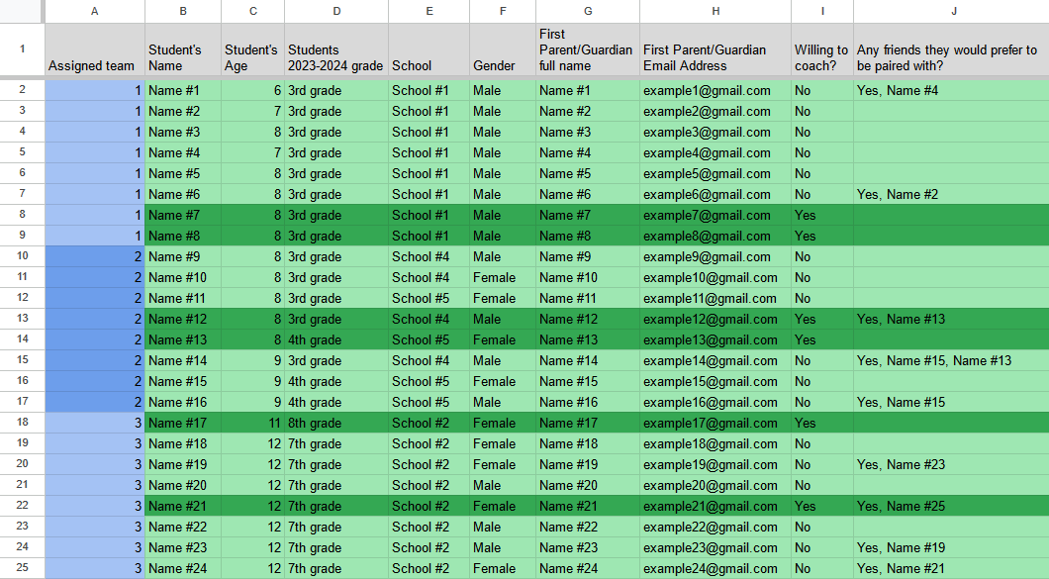
How to Make Teams
When creating teams, consider:
  Friendships
  Age
  Location
  Gender
Parent volunteers (coaches) = limiting factor
Example of how we sort our created teams

Slide 13
How to Plan Events
Who - more students, a few adults (judges). How many youth teams to invite?
What - competition and practice fields, A/V, printer, power cords, floor protection, signs, etc.
When - all day Saturday or Sunday. Start early for setup!
Where - High School Gym or similar size.
How much -$50 fee covers insurance, supplies and helps prevent no shows

Slide 14
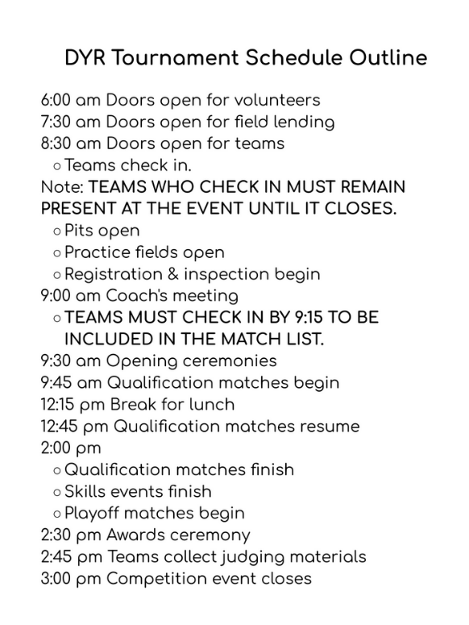
How to Run Events
Setup
  Start early!
  Layout plan before day of event
Designated volunteer roles
Have a set schedule
  Example outline →
Notes:
Setup
Make sure to start early, so if problems occur you have enough time to fix them before the event actually starts!
You also want to make sure that you already have a plan for setup before you actually begin setting up. This helps keep everyone on the same page, and also makes the whole setup process much more efficient!
You want to have designated volunteer roles, so people know exactly what they are doing. Designated roles help keep things organized
We have “leads” of certain roles (lead queuer, lead field reset, etc.) who are more responsible and can help to keep track of other volunteers
Helps to keep everyone on task!
You also want to make sure you have a schedule. With a schedule you can make sure that you are staying on track and have time to fit everything in!
The schedule sometimes will go off track; thats ok! If its off track, try to pinpoint what is slowing down the event and adjust accordingly
(example of queuers being slow for our DYR tournament)

Slide 15
How to Maintain the League
Documentation!!!
  What went well
  What to improve
  Essential, especially if prior coordinator is graduating
Transfer in leadership
  More communication = smoother process!
Collect feedback
Notes:
Documentation is one of the most important factors
Good documentation allows for people who have never run the league before to understand how the system is run
Document what went well, but also any document any struggles you might have faced.
Documentation is especially important because leadership changes over the years
New leaders should be able to continue to build upon the system, not have to start from scratch every year
On our team, the coordinators tend to switch each year
This means that each year the new coordinator has to learn how to run the league
Communication is especially important
Previous lead teaches/provides resources for new lead to build upon
You also want to collect feedback about the program
Can be from people participating in the program, but also the volunteers!
This helps you figure out what could be improved next year/what went well

Slide 16
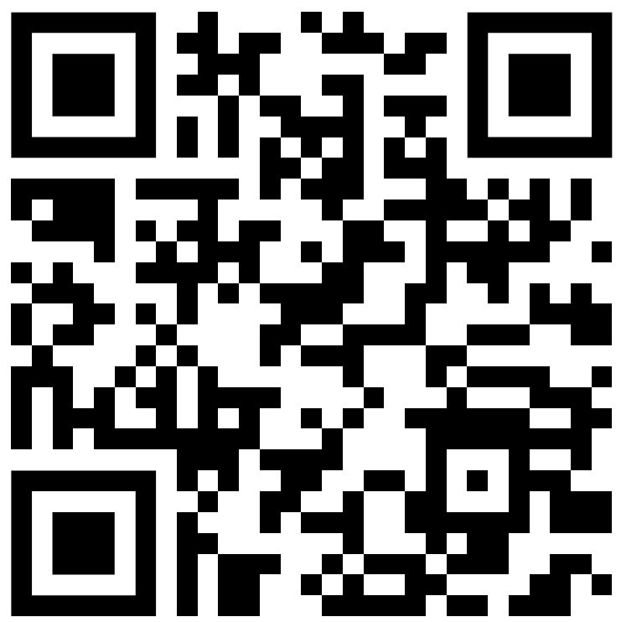
Feedback

Slide 17
Citrus Circuits
Fall Workshop Series
Contact us @
davisyouthrobotics@citruscircuits.org
Thank You! Any Questions?

