Slide 1
Citrus Circuits
Fall Workshop Series
Team Branding
by Brook Ostrom
Business & Media Mentor
Team 1678 Citrus Circuits

Slide 2
What is a “Brand?”
“A brand is a product, service or concept that is publicly distinguished from other products, services or concepts so that it can be easily communicated and usually marketed.
Branding is the process of creating and disseminating the brand name, its qualities and personality. Branding could be applied to the entire corporate identity as well as to individual products and services or concepts.”

Slide 3
What is a “Brand?”
Not just your logo
Includes everything that supports your logo
Fonts, colors, styles, location, position
Can also include what your team wears at competition
Identifiable and Consistent

Slide 4
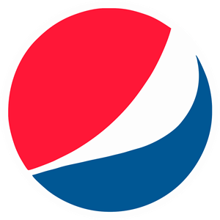
Corporate Brands

Slide 5
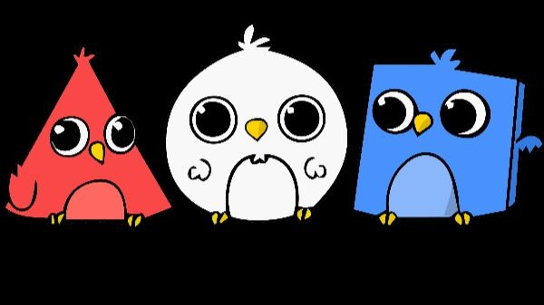
FRC Team Brands

Slide 6
Developing a Brand
Decide what works for your team
Try out ideas on your audience (students, parents, mentors)
What do you want the brand to communicate?
Competitive / Serious
Fun / Approachable
School-based / Independent
What design choices support your brand?
Color
Font
Complexity
Scalability

Slide 7
Maintaining A Brand
Branding Standards
Written guidelines for all uses of your brand
Include everything that supports brand use
Primary and secondary fonts
Color palette in RGB, CMYK, PMS and Hexadecimal
Use on light and dark backgrounds
Sizing and alternatives
Acceptable and unacceptable variations
Rules for modifying the brand for special cases

Slide 8
Branding STandards in FRC
Team 1528 Holy Cows
Comprehensive graphics and brand application standards
Team 3128 Aluminium Narwhals
Good examples of how to adapt and apply their brand
Exploding Bacon Team 1902
Online branding and imagery presentations

Slide 9
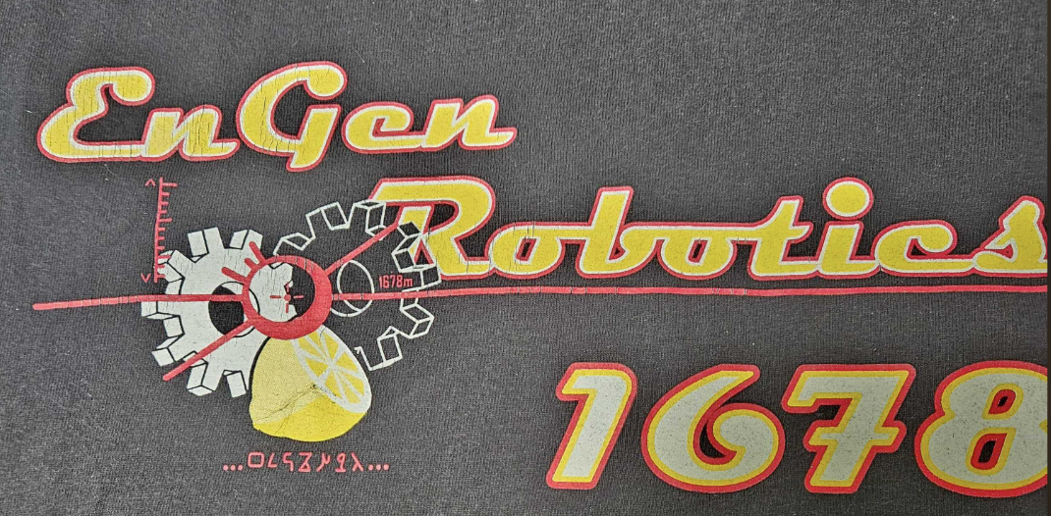
Brand Evolution

Slide 10
Brand Variations

Slide 11
Supporting Brands
Citrus Circuits has developed associated brands that work with and stand apart from core team branding

Slide 12
Your Brand
What do you like about your team brand/image?
Do you have branding standards or guidelines for using your team brand or logo?
What would you change about your brand?
What other team brands do you like?

Slide 13
Supporting Brand Identity
Develop a brand and image your team likes
Try to maintain a consistent look to your brand
Don’t make big changes often
Consider variations carefully
Have branding standards that everyone understands and is committed to

Slide 14
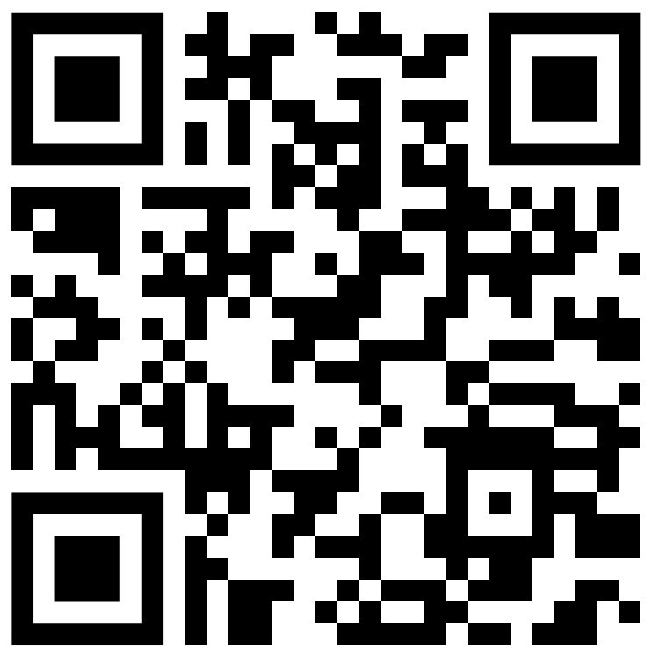
Questions?
Give Us Feedback!

Slide 15
Citrus Circuits
Fall Workshop Series
media@citruscircuits.org
Thank You!

