Slide 1
Citrus Circuits
Fall Workshop Series
Effective Scouting in FRC
by Nathan Mills

Slide 2
What is Scouting?
Purpose
Get data on teams for strategy
Match Strategy
Alliance Selection
4 Parts of Scouting
Collection
Storage
Data processing
Visualization

Slide 3
Data Collection
Paper Scouting
Easy to start, low resource cost
Difficult to process and visualize data
Google forms
Easy to make, provides good data
Easy to visualize
Needs phones/other device
Apps
More freedom and control over data collection
Larger investment by the team.
Might need laptops or tablets

Slide 4
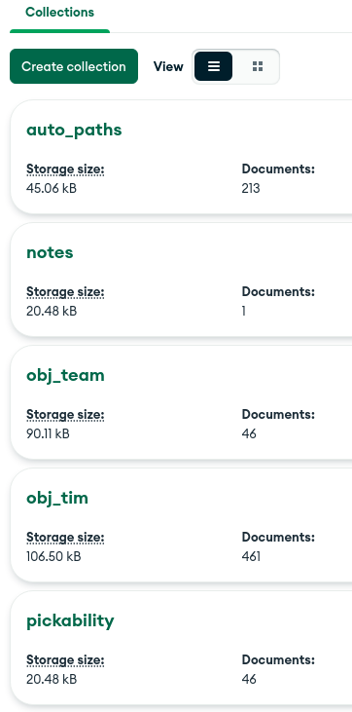
Data Storage
Spreadsheets
Links well to google forms
Databases
SQL
table structure
NoSQL
Stores static documents

Slide 5
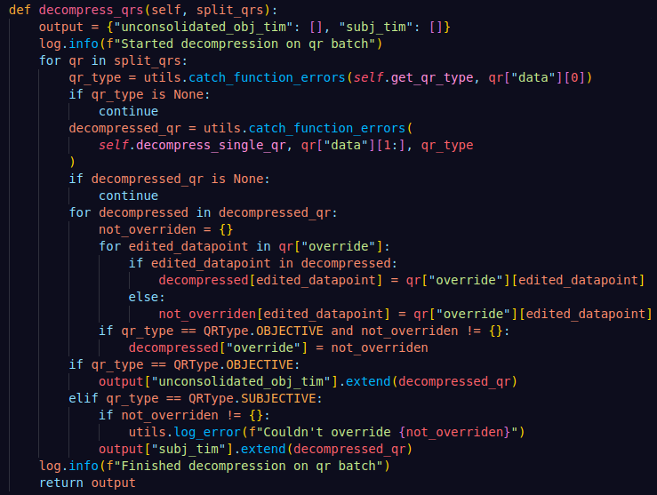
Data Processing
Averages
Mean, Median, Mode
Weighted Sums
Predictions
Rankings
RP
Scores
Last Four Matches (LFM)
Calculations run on the last four matches
Better idea of team’s current abilities

Slide 6
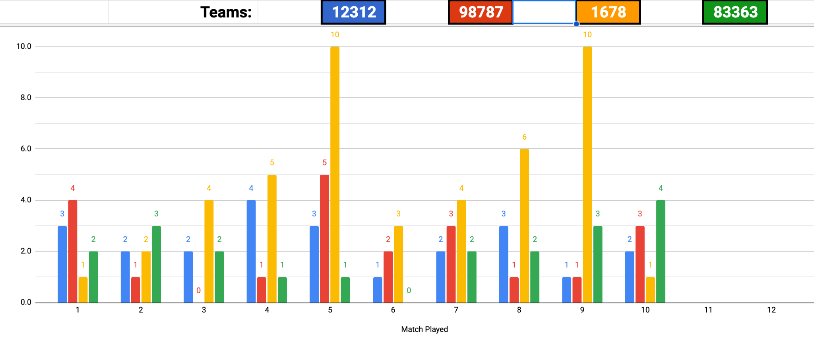
Data Visualization
Spreadsheets (Again!)
Data Visualization Tools
Tableau
An App or Website
Much more customizable

Slide 7
Objective vs Subjective Scouting
Quantitative vs Qualitative
Which one do you prioritize?
How many scouts do you have
Your own needs
Do you want long descriptive info?
Or do you want objective stats?
Some forms of data collection are more suited for one over the other.

Slide 8
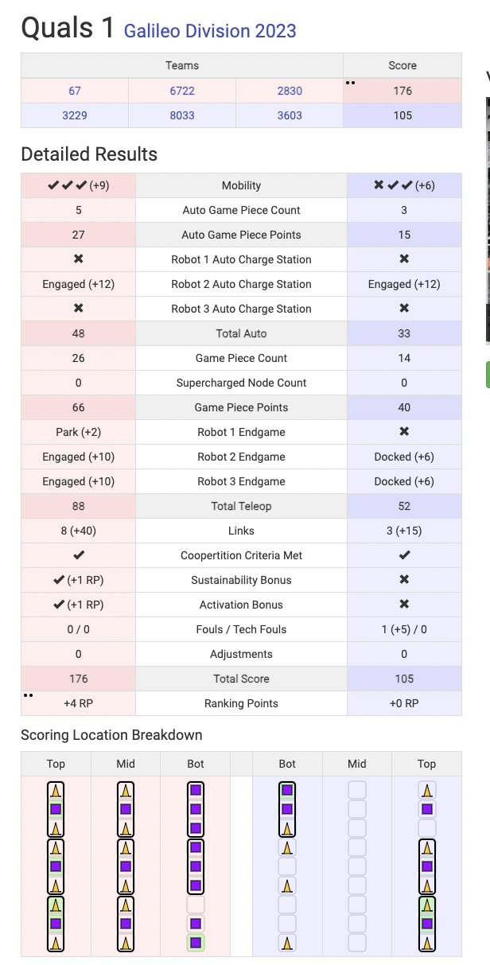
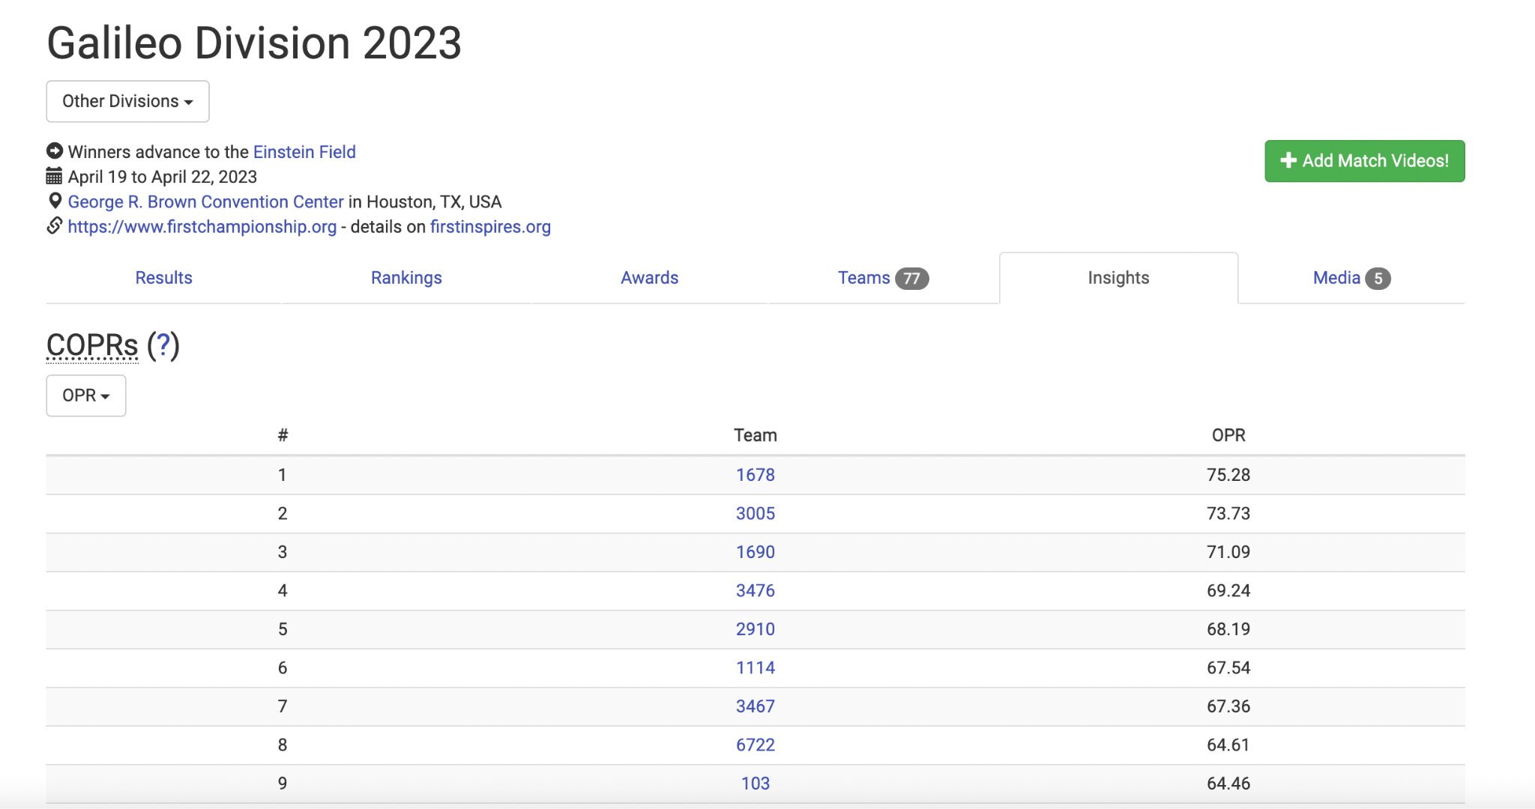
Use TBA!
Fantastic source of data
So is statbotics.io!
Lots of additional data
OPRs

Slide 9
Small Teams vs Large Teams
Small Teams
More subjective
1 scout per alliance
Utilize TBA and Statbotics!
Large Teams
Objective scouts per robot
Subjective scouts per robot/alliance

Slide 10
Importance of Scouting Rotations
Scouting is tiring
Scouting fatigue is real!
Help prevent fatigue with breaks
Leads to better data
Scouts like breaks! Let them have fun at comp.

Slide 11
What Our Scouting System Looks Like
Ours isn’t perfect either…

Slide 12
Purpose/Overview
Scouting/Pit data
Data collection
Processing/calculations
Visualization
Picklist creation
Match strategy
Server
Viewer
Picklist Editor
Match strategy
Alliance selection
Win competitions!

Slide 13
Structure
Front End - Apps
Kotlin and XML
Collection
Visualization
Back End - Server
Python
Calculations
Database

Slide 14
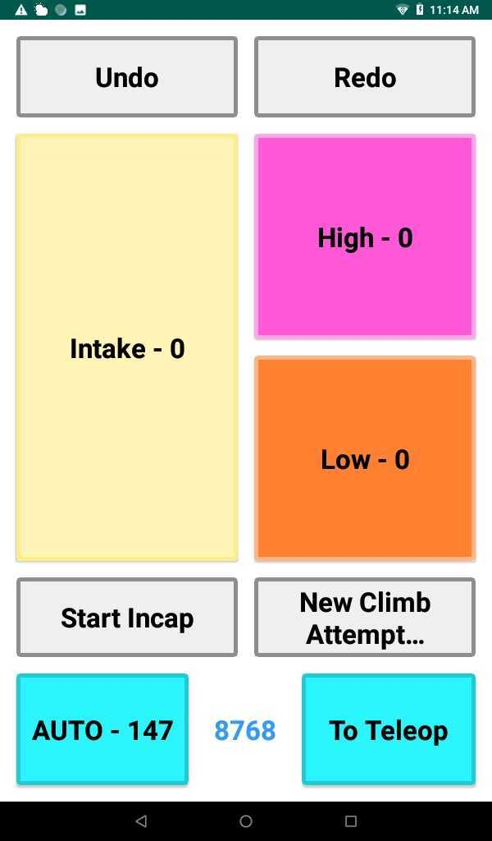
Match Collection
Run on tablets
Scout (sub-app)
Objective data
18 scouts
3 per robot

Slide 15
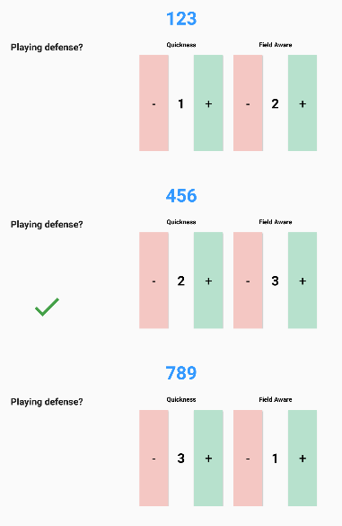
Match Collection
Super Scout (sub-app)
Subjective data
Ordinal ranking
3 is best, 1 is worst
1 scout per alliance

Slide 16
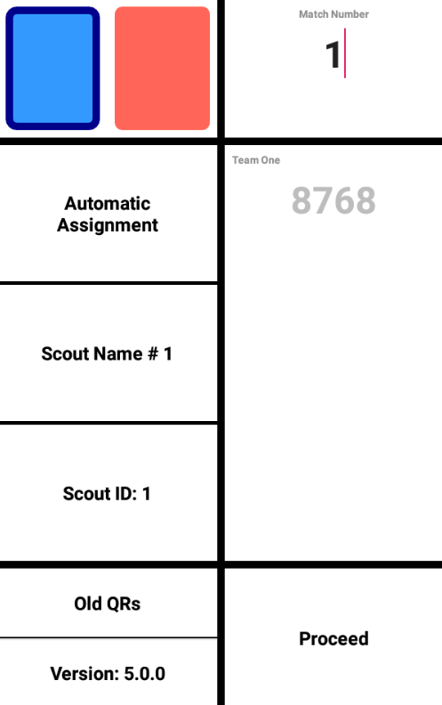
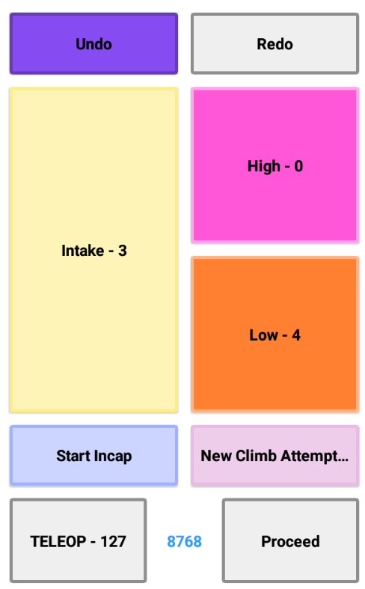
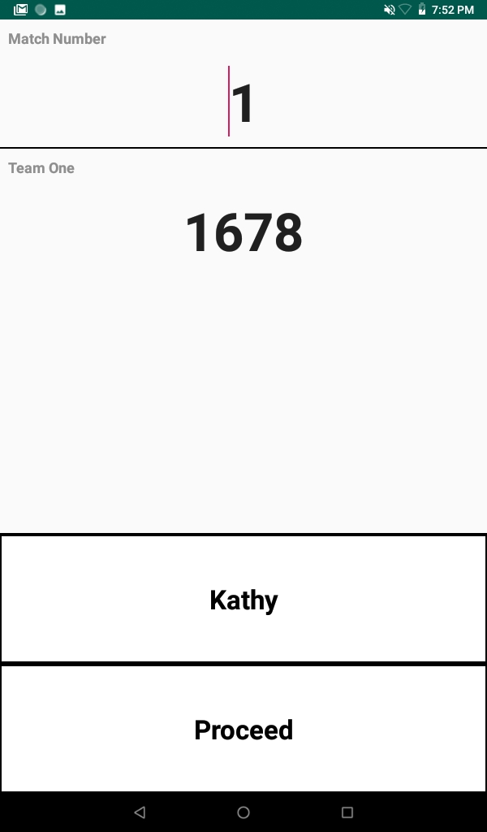
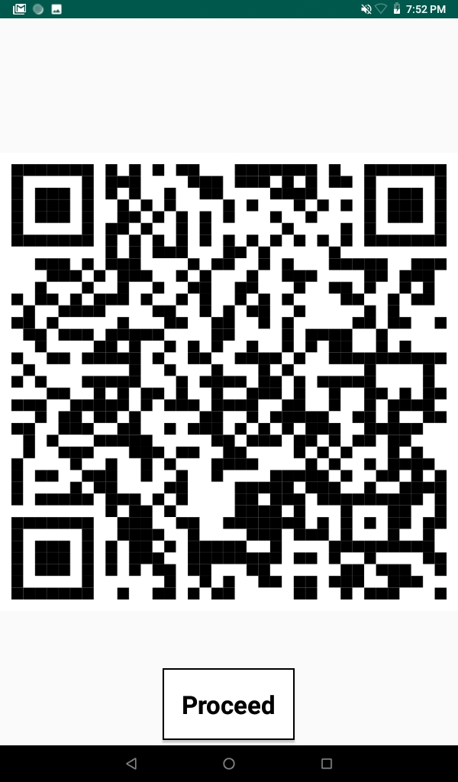
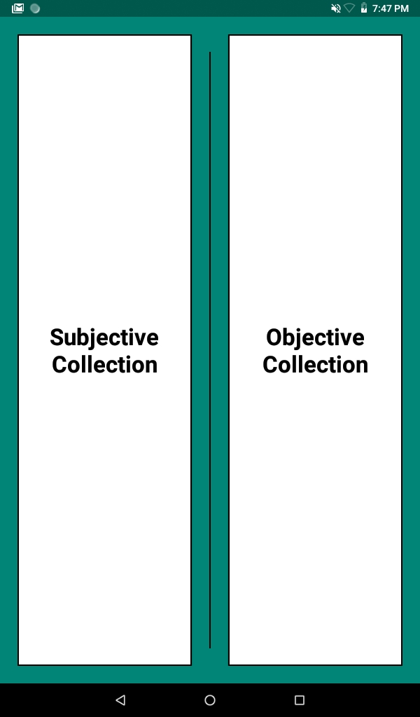
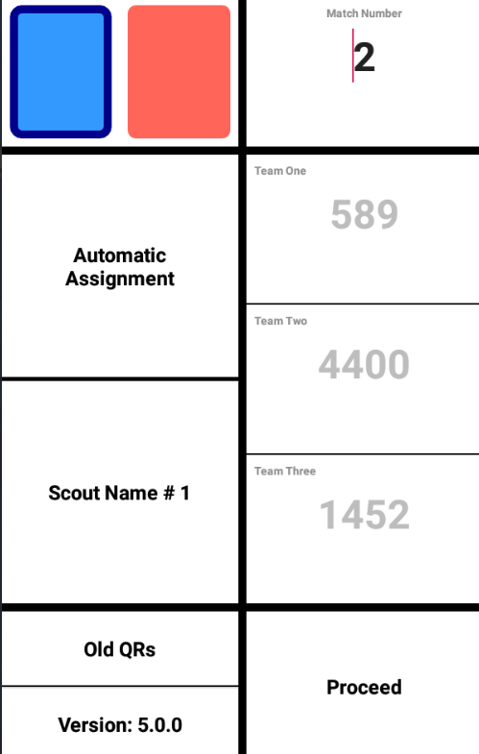
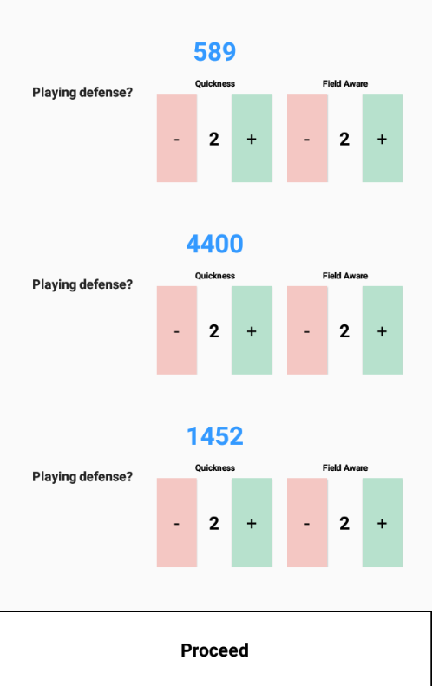
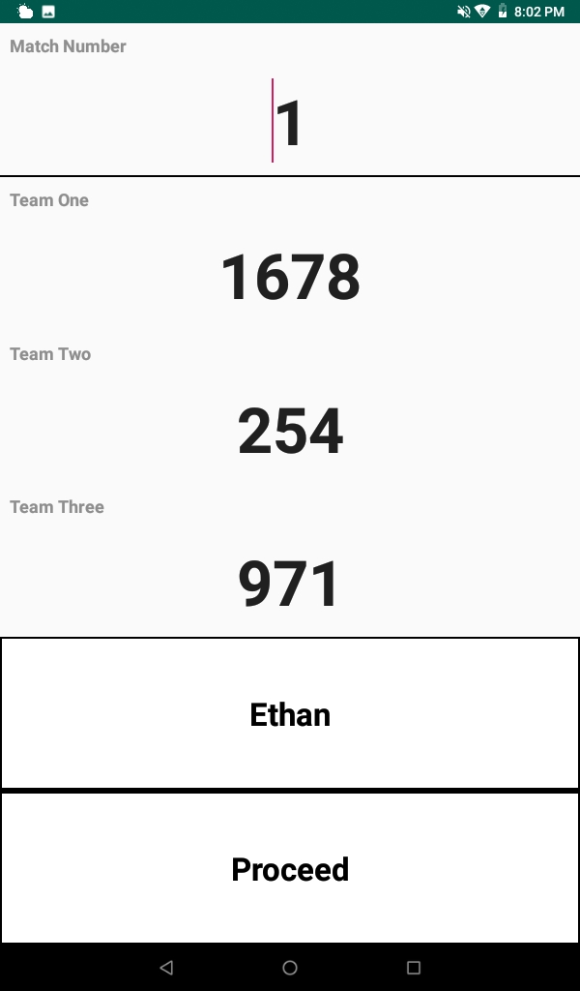
App Flow
Scout
Match Info Input
Match Collection
Match Info Edit
QR
Mode Selection
Super Scout

Slide 17
Why QRs?
Alternatives:
Wifi
Bluetooth
USB
How it works in the stands
Notes:
Transfer collected data to our database through QR Data Transfer mobile application on scouts’ phones.
WiFi and mobile hotspots not allowed - unable to give scouting tablets an Internet connection.
USB cords to connect tablets directly to computer - cords are too messy.
Bluetooth connection between tablets and computer - interference, especially difficult for those farthest away from the computer.
As mentioned earlier, we transfer the data collected by scouts to our database through our QR Data Transfer mobile application. Because the tablets that we scout on do not have data or Internet connection, we have to send data to our database via scouts’ cell phones. The QR Data Transfer app that is downloaded onto the scouts’ phones scans the QR generated by our collection applications and sends the data to our database.
We first used QR as our data transfer system in the 2018 season; before then, we tried various other methods.
In competition venues, WiFi and mobile hotspots are not allowed, so we were unable to give the scouting tablets an Internet connection.
We discussed using USB cords to connect the tablets directly to the computer with a direct hotspot, but all those cords in the stands was really messy.
We also tried transferring files via bluetooth connection, from the tablets to the computer, but there was a lot of interference, and it was very difficult to maintain bluetooth connection, especially for those farther away from the computer.
After trying these methods to transfer data from our scouting tablets to our online database, we landed on QR, which did not require a hotspot or WiFi as most scouts’ phones had data - we found it to be the most reliable data transfer method, with very minimal data being lost during transfer, if any.

Slide 18
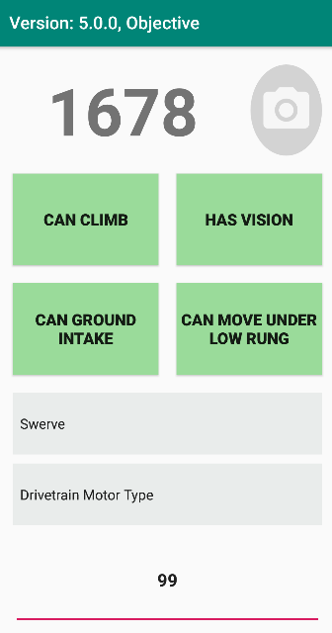
Pit Collection
Run on phone
Collects objective pit data
Ex: weight, drivetrain, pictures, etc.
1 scout
In past years, both objective and subjective

Slide 19
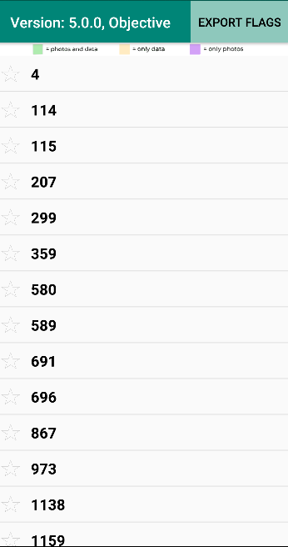
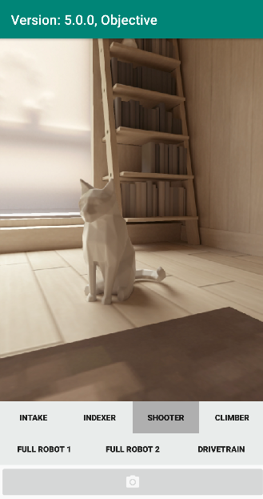
App Flow
Collection
Photos
Teams List
Collection
Photos

Slide 20
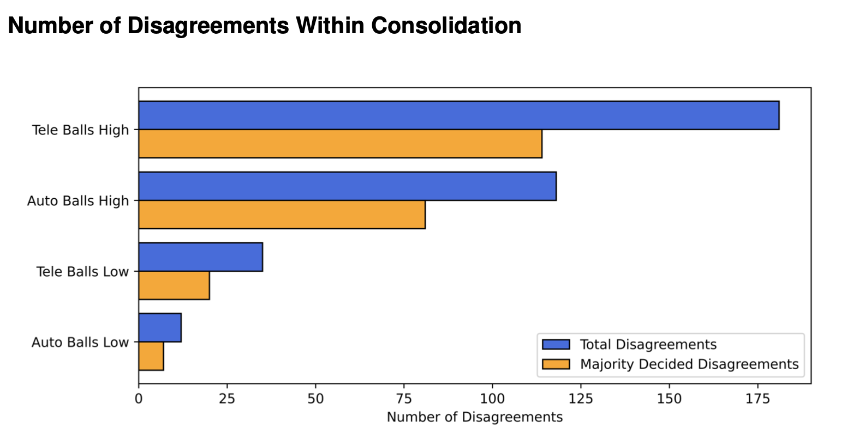
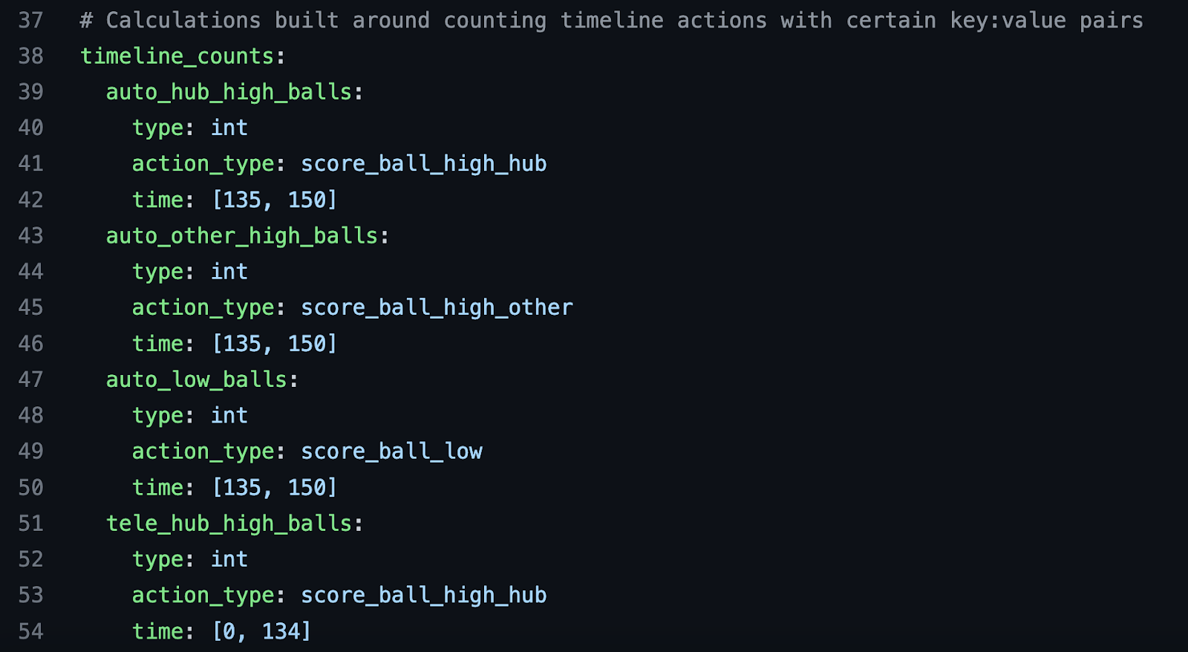
Back End
Calculations
Consolidation
Averages
Predictions
Pickability
Schema
How we format data
Grosbeak

Slide 21
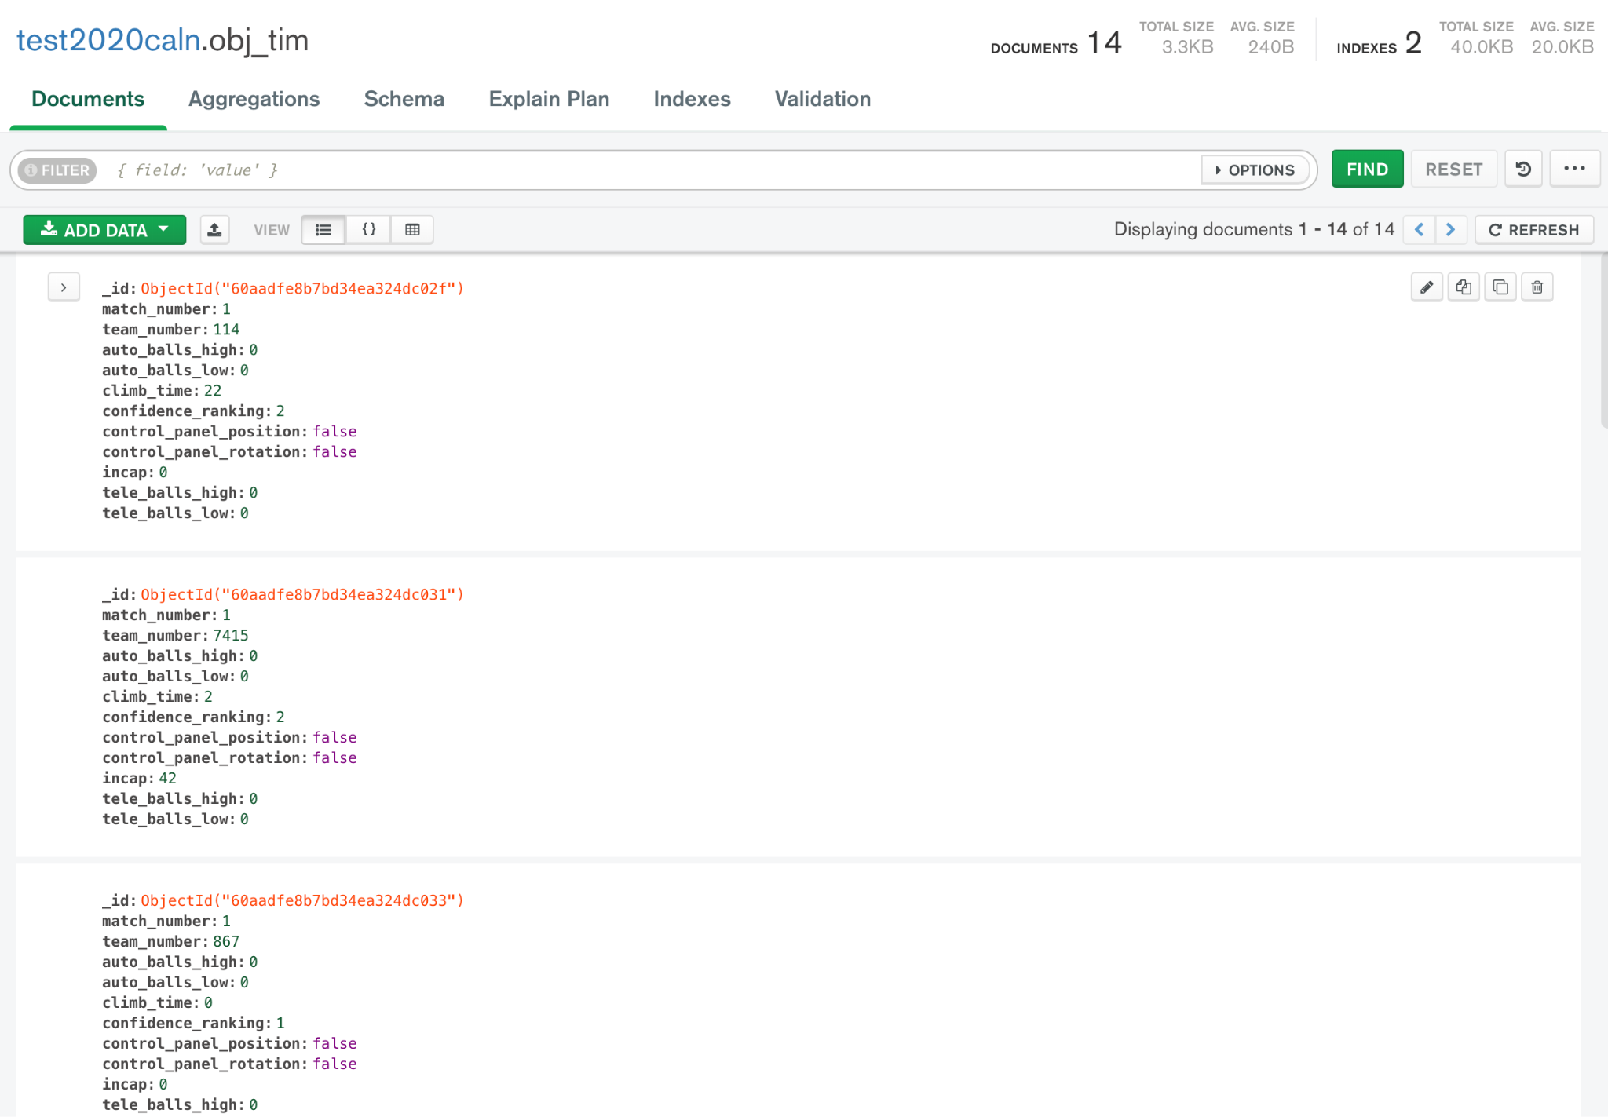
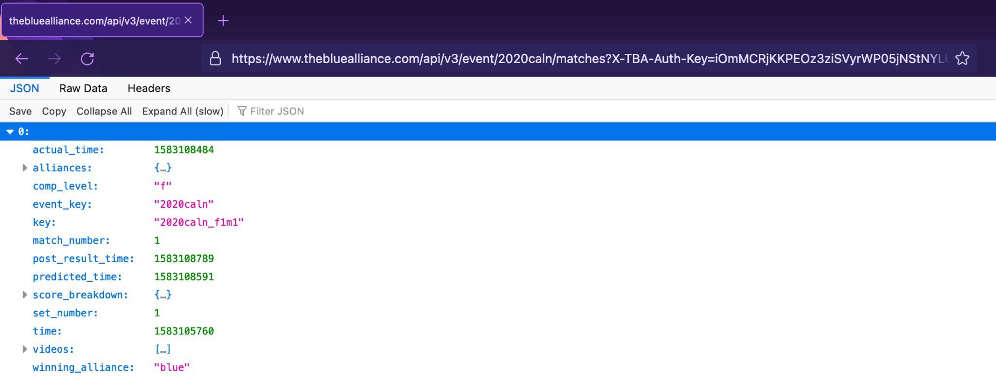
Server
MongoDB
Local Database
Cloud Database
The Blue Alliance
Provides us with
additional data

Slide 22
MongoDB - Database Structure
No SQL
No tables
Document based

Slide 23
Manipulating Data in MongoDB
CRUD Operations:
Create: Inserting new documents
Read: Pulling documents from the database
Update: Changing existing documents
Delete: Removing documents
There are many ways to change the behavior of these operations according to what you need to do with the data

Slide 24
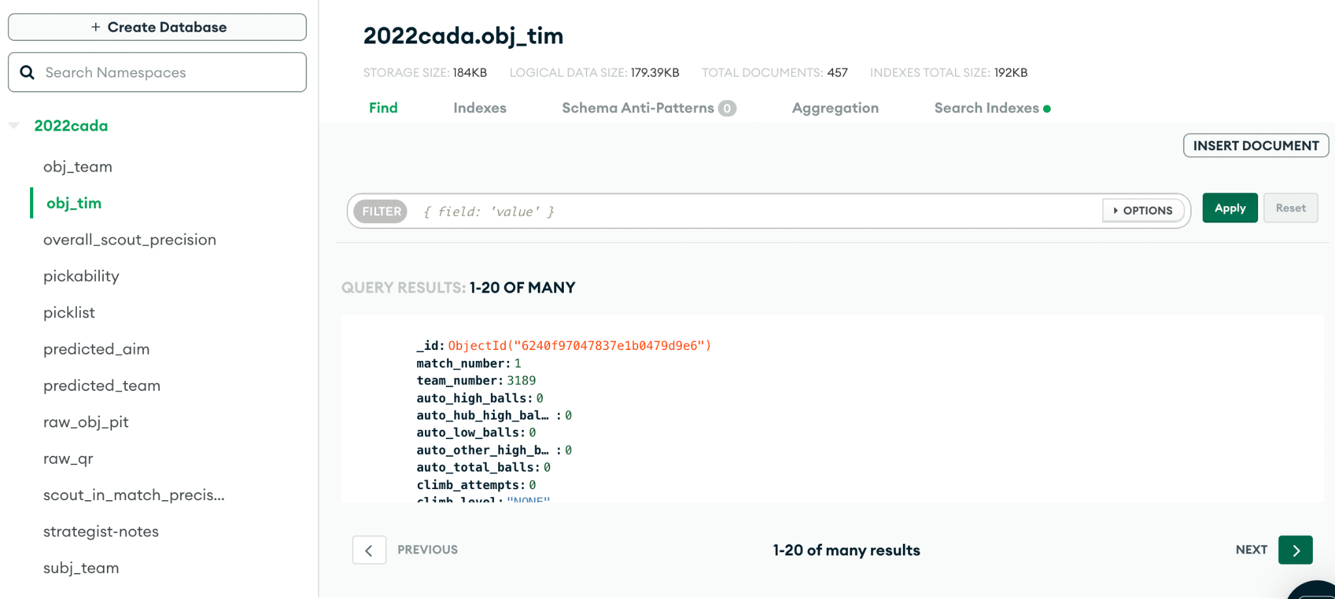
MongoDB - Database Structure
New and Improved Version
Database
Collections
Documents

Slide 25
Grosbeak—Web Server
Serves MongoDB data to the Viewer app
Cloud Database
Grosbeak
Viewer
Local Database

Slide 26
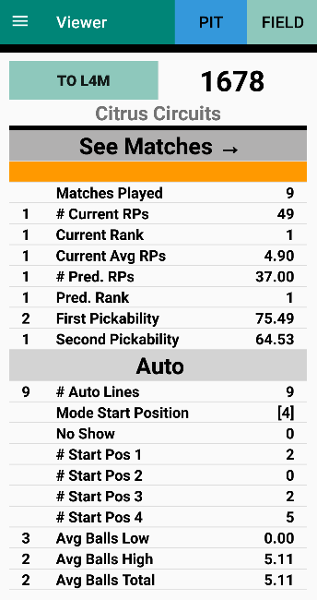
Visualization—Data Viewer
Run on phones
Used by strategists
Graphing, rankings, lists, notes, live/offline picklist, pickability, match schedule
Notes:
i und sind

Slide 27
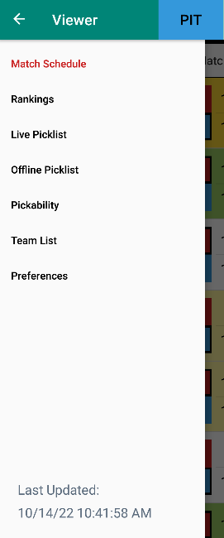
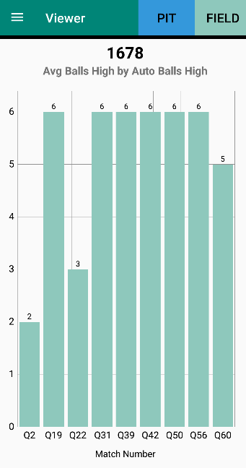
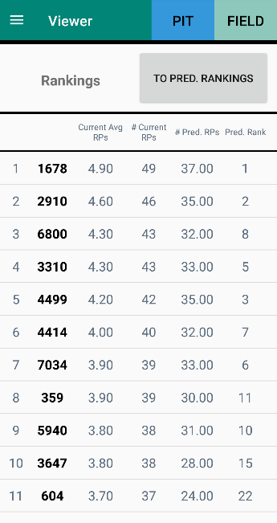
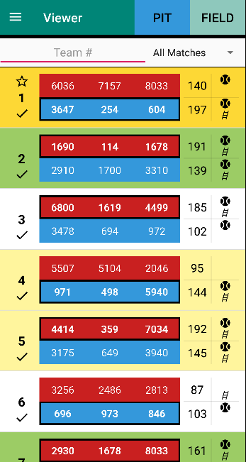
Data Viewer Screens
Graphs Rankings Schedule

Slide 28
Visualization—Picklist Spreadsheet
Picklist meetings
Automated Google spreadsheet—Google App Script
Picklist, DNPs, Graphs, Settings, CSVs

Slide 29
System At Competition
Stands Pits
Lead Scout + Assistant
Pit Strategist (1)
Strategic Mentors (~4)
Data Collection
System Management
Scouts
(18 + ~3)
Super Scouts
(2 + 1)
Stands Strategists
(2)
Video System (2)
Scouting Developers
(2 + 2)

Slide 30
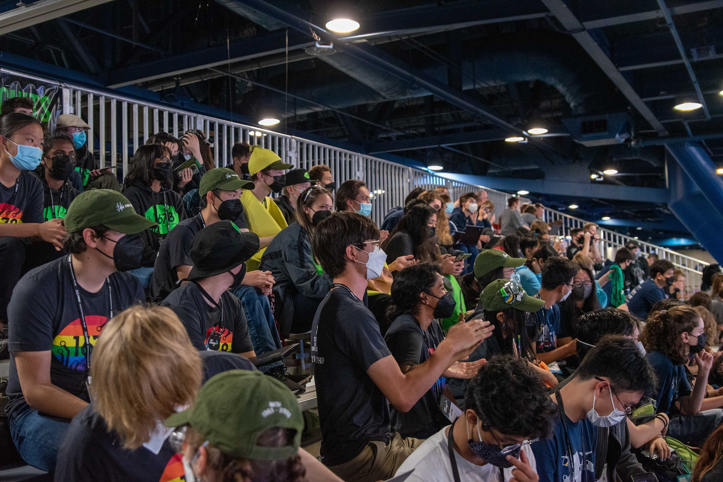
System Philosophies
Documentation
Minimize year-specific features
End-to-end development
Testing!
User communication
Minimize info overload
Training
Collaboration with Strategy subteam

Slide 31
Resources
Resources - 1678
1678 Whitepapers: citruscircuits.org/scouting
1678 Github:
github.com/frc1678
Notes:
Carl

Slide 32
Citrus Circuits
Fall Workshop Series
softwarescouting@citruscircuits.org
Thank you!

