Slide 1

Citrus Circuits
Fall Workshop Series
1678 Team Structure and Management
Kina Li and Steven Zhang
Notes:
Introductions:
Katie: Captain, previously Business/Media subteam lead, previously small outreach lead of the booth at our Farmer’s Market
Emily: Vice Captain, previously outreach lead of summer robotics camps, current outreach lead of Shelter Finder App

Slide 2
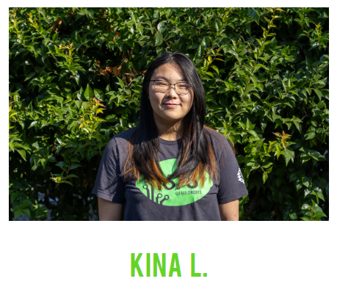
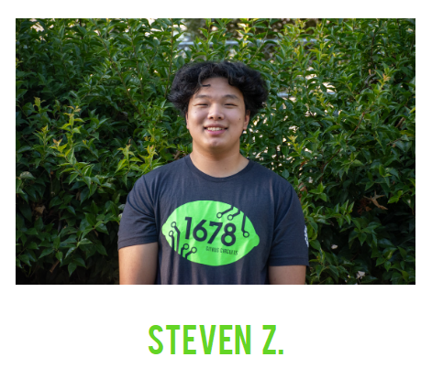
Who Are We？
Captains of 1678 for the 2023-24 season
  Fourth-year students
  Kina: Hardware Design & Strategy
  Steven: Hardware Fabrication & Impact Award
Take what we say with a grain of salt :)
Notes:
Kina
Steven

Slide 3
Vision and Mission
Vision: what your view for the future is
Mission: how you pursue your vision
Everything your team does should link back to your vision and mission statements!
Notes:
Kina

Slide 4
1678 Vision and Mission Statements
Vision
We transform our communities through education; we engage people of all ages through outreach; we inspire others with our commitment to excellence. We strive to Educate, Empower, and Excel.
Mission
Team 1678 pursues our vision by building a student-led, mentor-based environment that fosters innovation and teaches interpersonal and technical skills. Citrus Circuits also develops local partnerships and community outreach while striving to compete at the highest level possible.
Educate. Empower. Excel.
Notes:
Steven Zhang

Slide 5
Team Structure
Core Leadership
Hardware
Software
Business & Media
Secondary
Subteams
Fabrication
Robot
Strategy
Electrical
Scouting
Impact Award
Design
Notes:
Kina (Core is made up of captains + brook + mike + Ms. Singh)

Slide 6
Team Structure
Hardware Fabrication Lead
Fabrication Subteam
Core Leadership
Leadership
Subteams
  Primary
  Secondary
Outreach Leads
Mentors
Hardware Design Lead
Design Subteam
Hardware Electrical Lead
Electrical Subteam
Software Robot Lead
Software Robot Subteam
Core Leadership
Software Scouting Lead
Software Robot Subteam
Business/Media Lead
Business/Media Subteam
Impact Lead
Impact Subteam
Strategy Lead
Strategy Subteam
Notes:
Steven

Slide 7
What does a year look like on 1678?
Build Season:
Early January - Late February
  6 weeks
Competition Season:
Early March- Mid April
  3-4 competitions a season
Offseason:
May-December
  Offseason Projects + Summer/Fall Outreach
  ~3 offseason events
Notes:
Steven

Slide 8
What does a typical meeting look like?
Weekday (W/Th):
General meeting (6:30 - 6:40)
Subteam work (6:40-8:45)
Clean 15 (8:45 - 9:00)
Build Season Weekend (Sat/Sun + Mon Holiday):
General meeting (9:00 - 9:10)
Subteam work (9:10-12:00)
Lunch (12:00 - 1:00)
Subteam work (1:00-4:45)
Clean 15 (4:45 - 5:00)
Notes:
Kina
Monday 9AM - 5PM when we don’t have school
Extra meetings as determined by subteam leads/mentors

Slide 9
Attendance Policy
General Policy:
We require students to maintain at least an 80% attendance rate
  Student Handbook 4.1.2
Evaluation will be at the end of every month and cuts will occur before build season
Possible Marks:
Present
Absent Unnotified - Partial Unnotified
Absent Notified - Partial Notified
Unproductive
Absent Excused - Partial Excused
Notes:
Steven
Extra meetings as determined by subteam leads/mentors

Slide 10

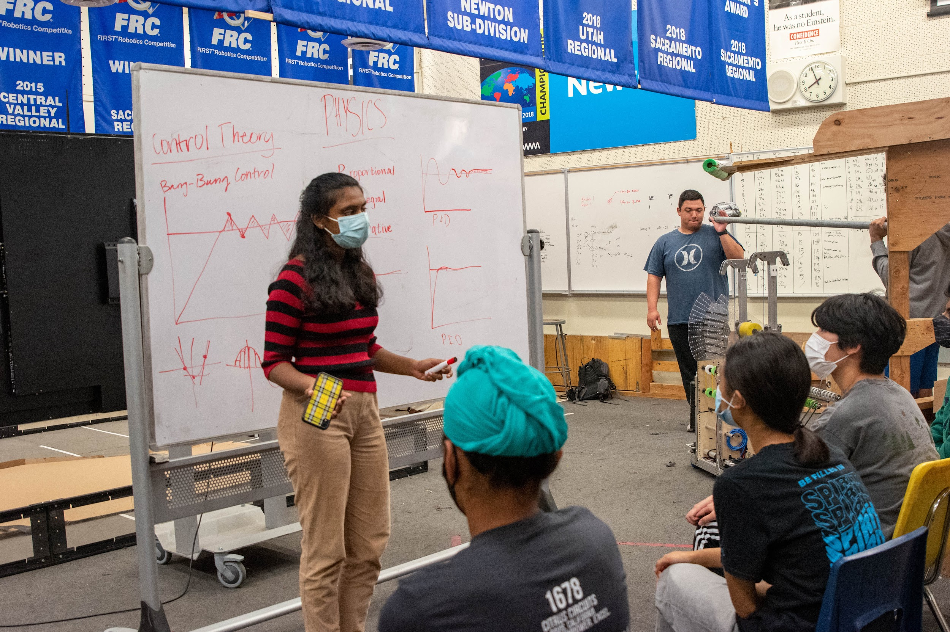
Peer-to-Peer Model
Sustainability!
Students become teachers
Does not rely on mentors
Builds student collaboration & communication skills
Notes:
1678 has learned over the years that a Peer-to-Peer program is the most sustainable educational model.
Allowing students to learn from each other is empowering
This is not going to happen in the first year but work towards it
By Year 3, the model should start working

Slide 11
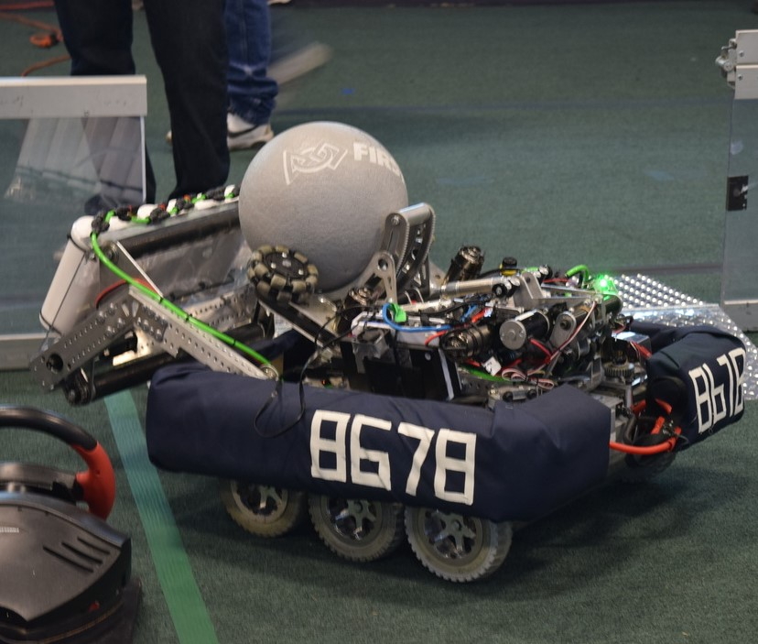
Off-Season Projects
Mock Kick-Off
Off-Season Robot
Prototyping Challenges
Rewire Last Season’s Bot
Mini Robot Competitions
Notes:
The easiest way to engage students during the off-season is with projects
Provide a hands-on learning experience
Practice the “engineering process”
Research – Ideate – Prototype – Test – Refine – Rinse and Repeat

Slide 12
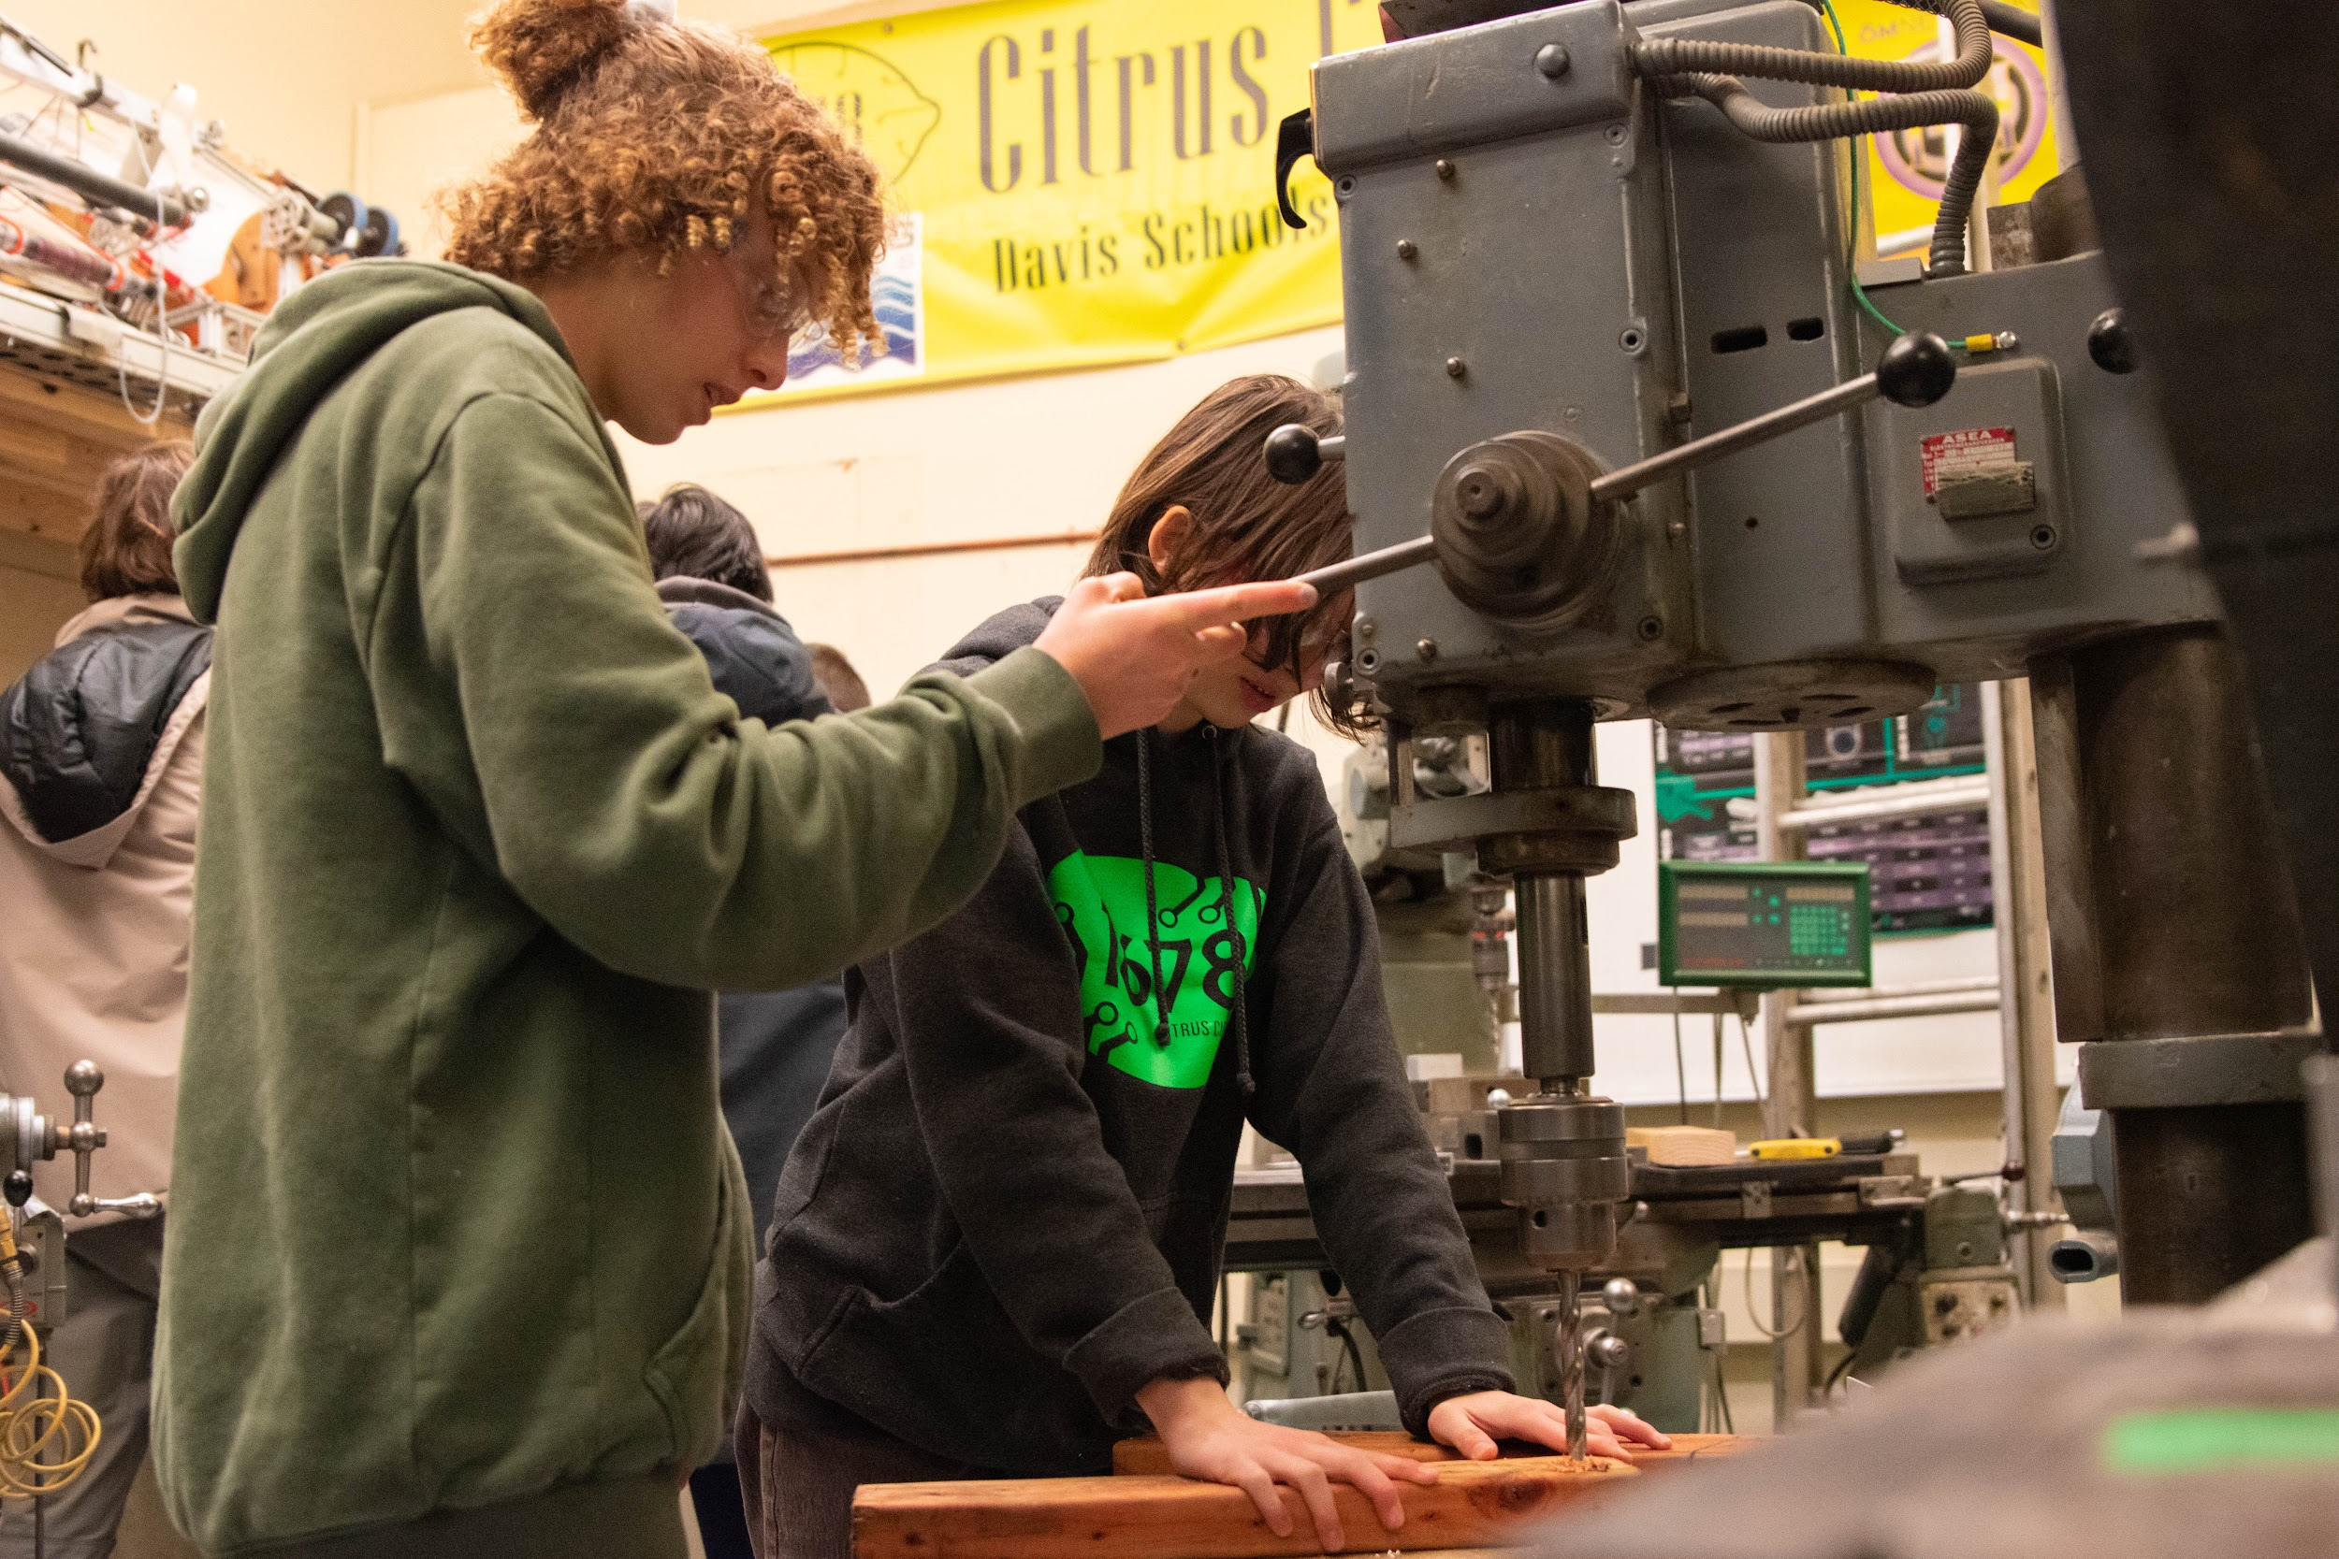
In-House Training
Tool and Machine Use
CAD Workshops
Programming Workshops
Electrical Workshops
Business/Media
Leadership Training
Notes:
Teach skills specific to FRC
Things as simple as soldering, crimping, how to use a hack saw, drilling straight
Workshops on writing, media, PR, leadership
If you don’t have students with knowledge, ask mentors/parents

Slide 13
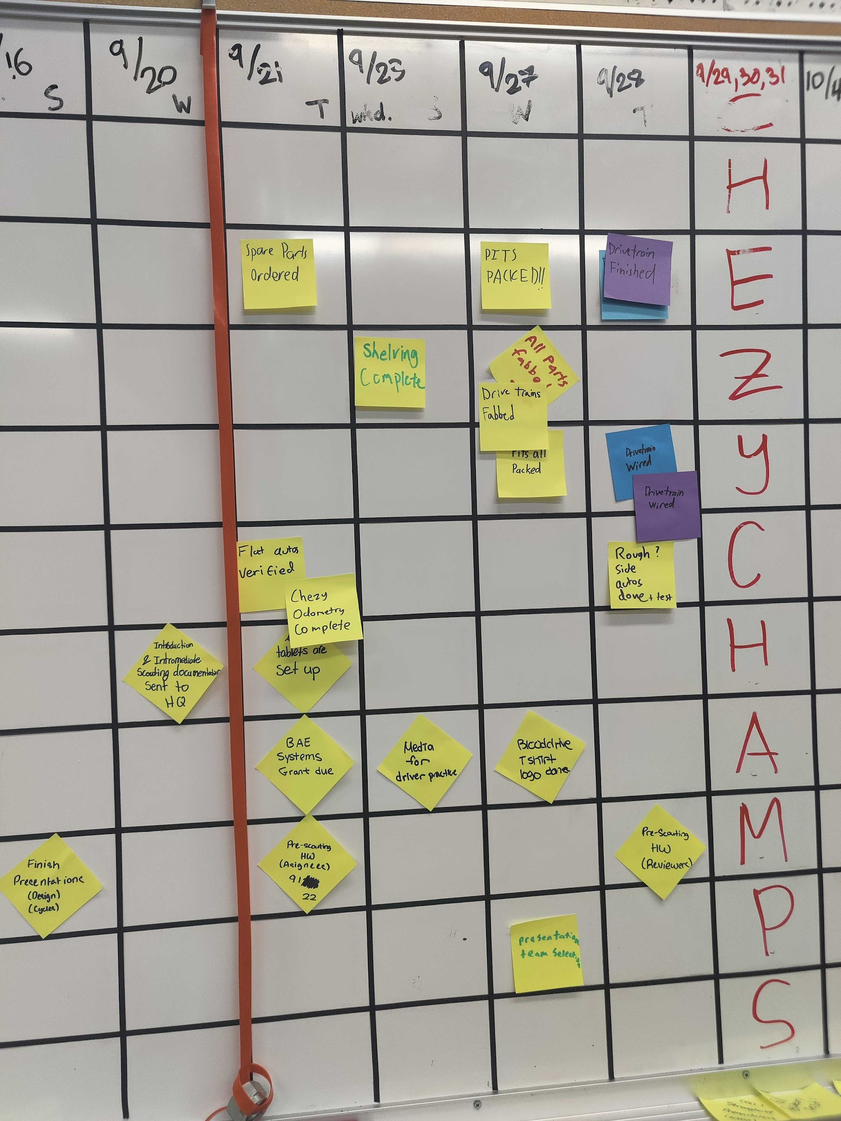
Setting Goals
Decide on goals
  Technical
  Cultural
  Personal
Decide your priorities
Decide your timeline
  Check-in points
Project management tracker: board, Slack channel, etc.
Notes:
Kina Li

Slide 14
Audience Activity!
Find someone on another team and share one of your team’s goals!
  Now share one new goal you think should be one of your team goals for this year
  Bonus: Share an example of how your team achieved one of your goals last year!

Slide 15
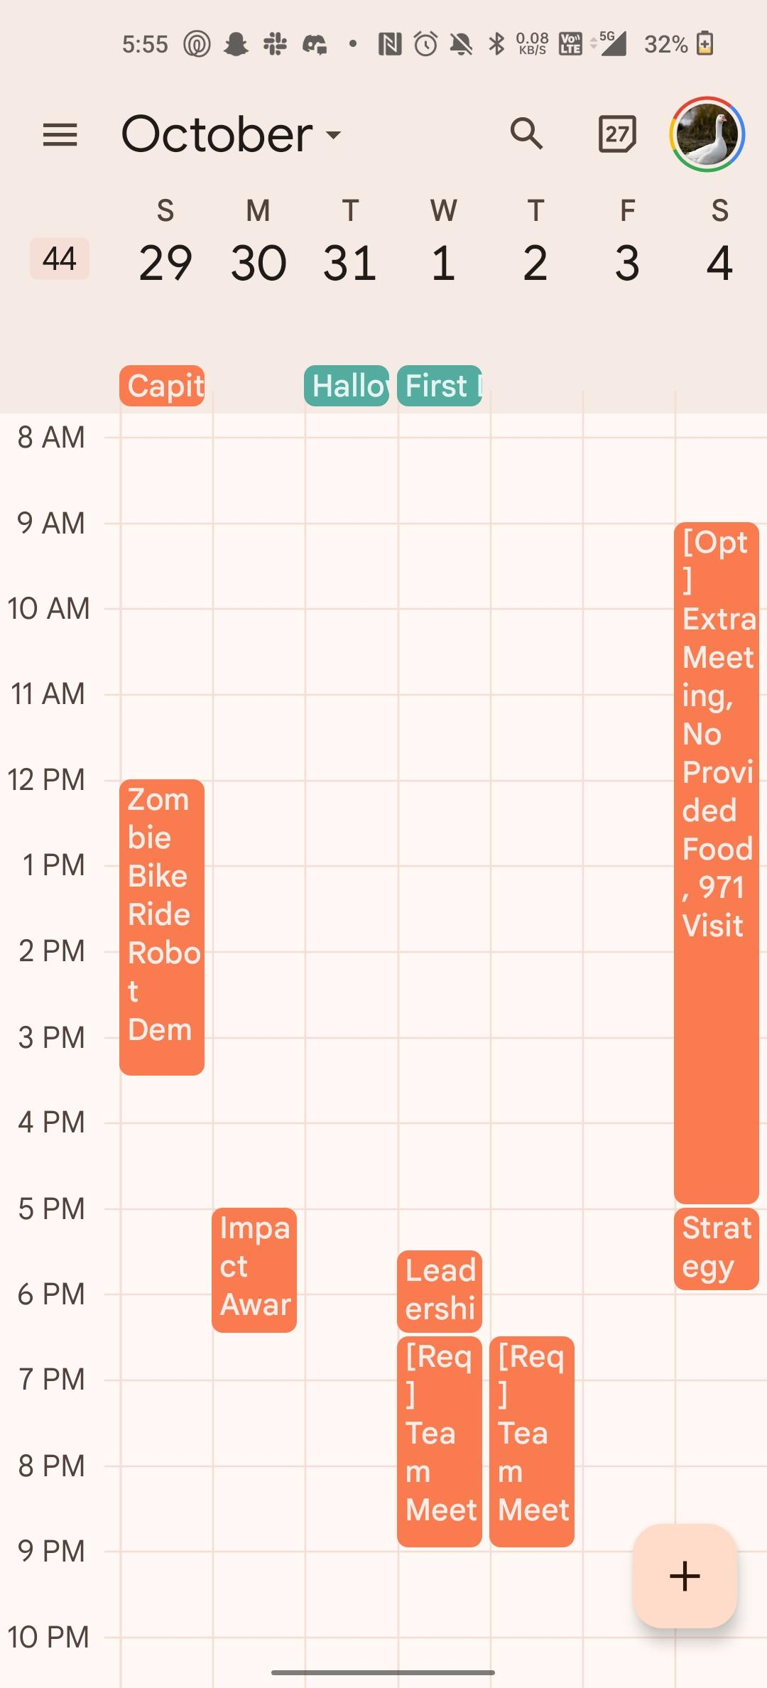
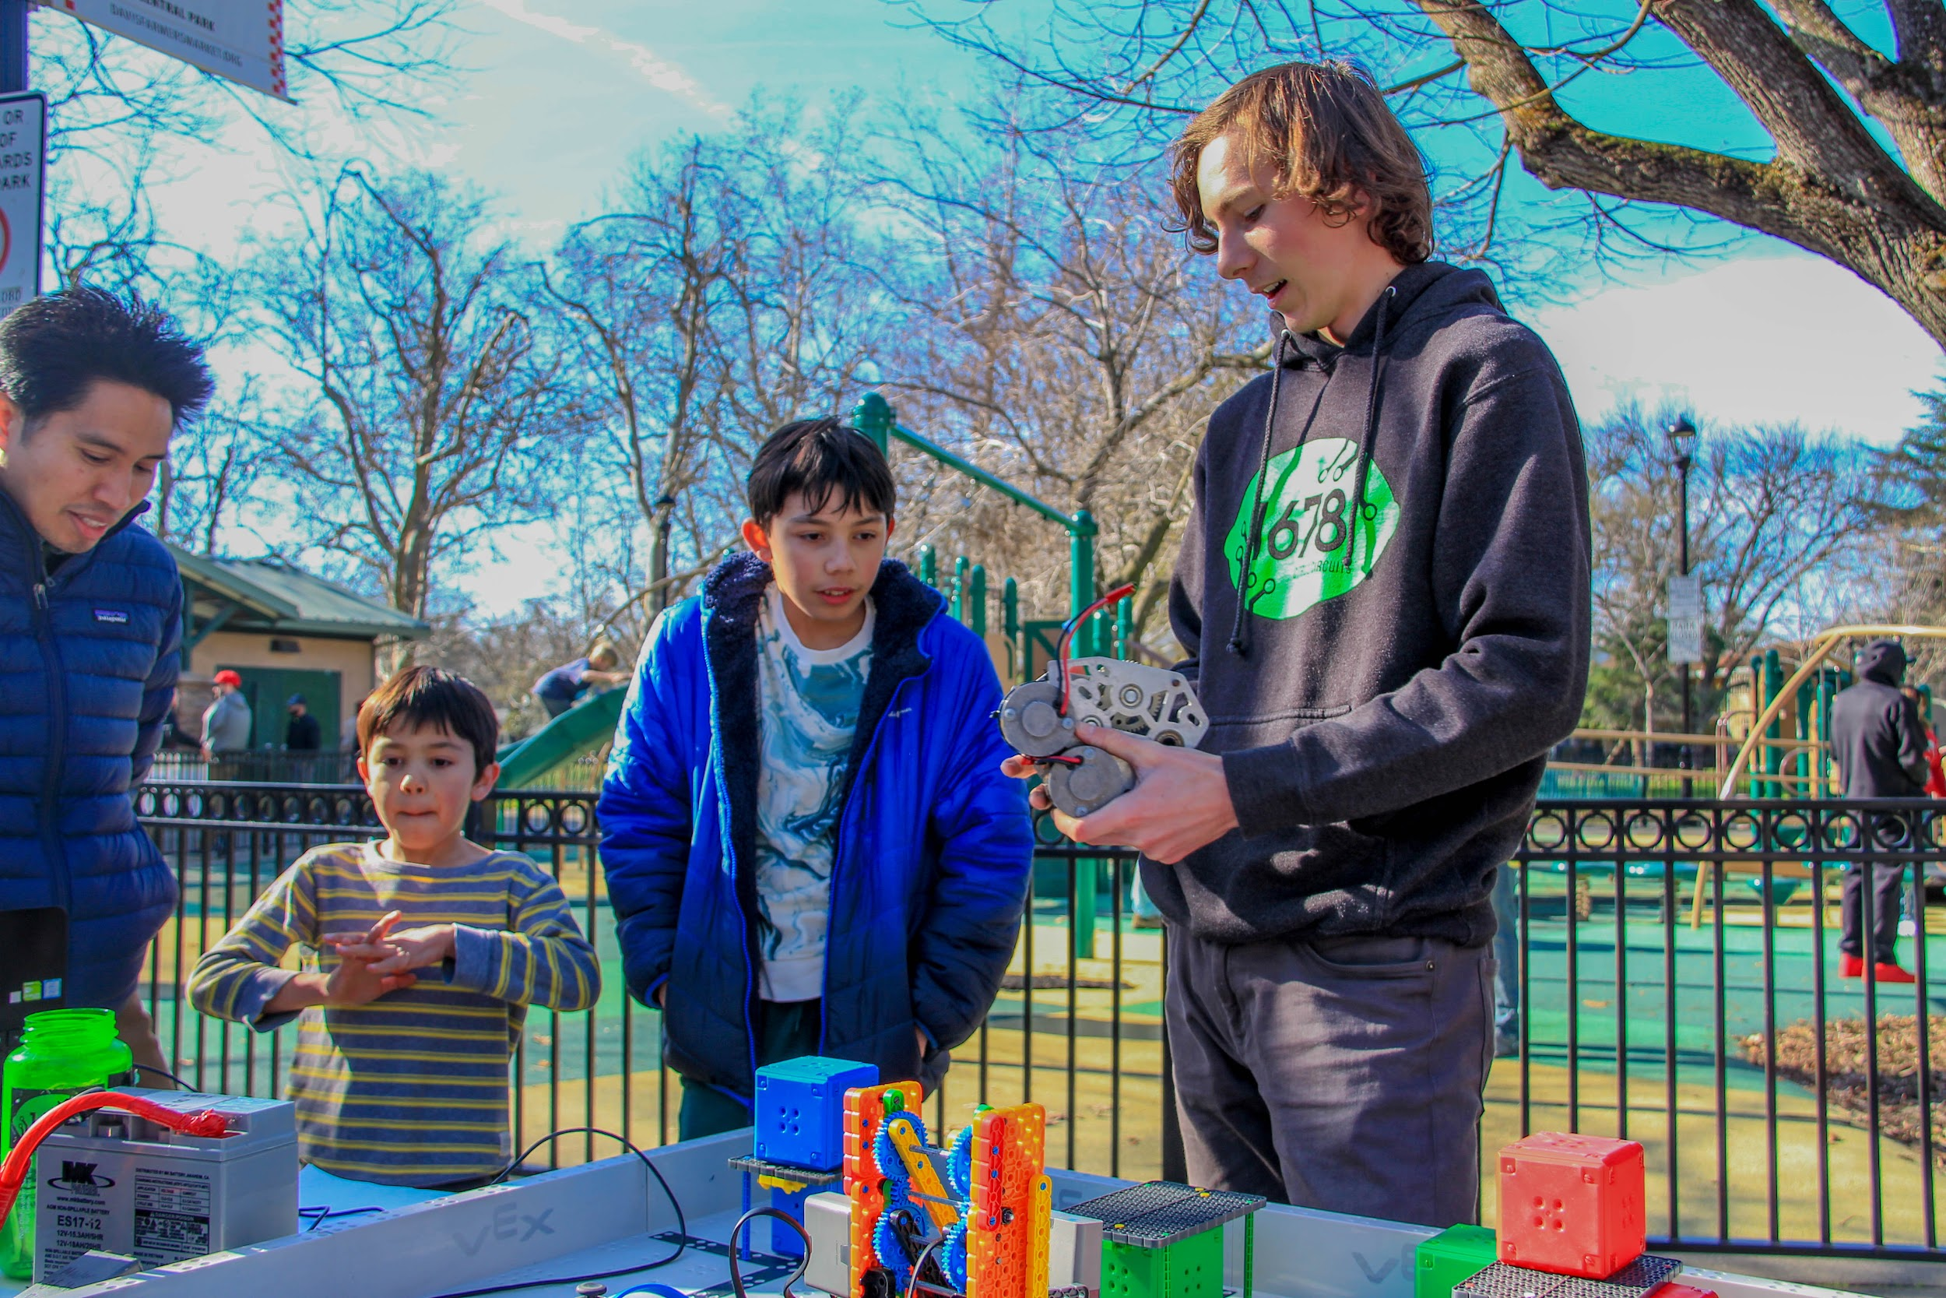
Planning and Scheduling
Meetings
  Leadership, regular + Extra
Schedules
  Google Calendar
Announcements
  Clarity, conciseness, accessibility
Notes:
Kina Li

Slide 16




Cat Herding (Logistics!)
Itineraries
  Schedule
  Meals
  Transportation
Flexibility
Communication
you
students
Notes:
Steven Zhang
One of the most important parts of being an effective student leader, especially in a competition setting, is being able to manage a large group of students. In our case that can be more than 40 students at any given competition. To be an effective “cat herder” per se requires you to be first and foremost timely and planned out. Holding things to a strict schedule or itinerary that outlines how the day will pan out is critical to keeping track of a group of people, large or small. For each event we have an itinerary that outlines our schedule for the day and critical information like addresses and transportation details.
Sadly, you can’t always follow your itinerary and schedule down to the letter so another important skill is being able to be flexible. Things are not going to go you way and things you couldn’t possibly foresee are going to blindside you. Being flexible, especially in what can be a tense and high pressure competition setting, is exceptionally important.
Lastly, being a good communicator does wonders for leading a group. Be clear and concise.

Slide 17
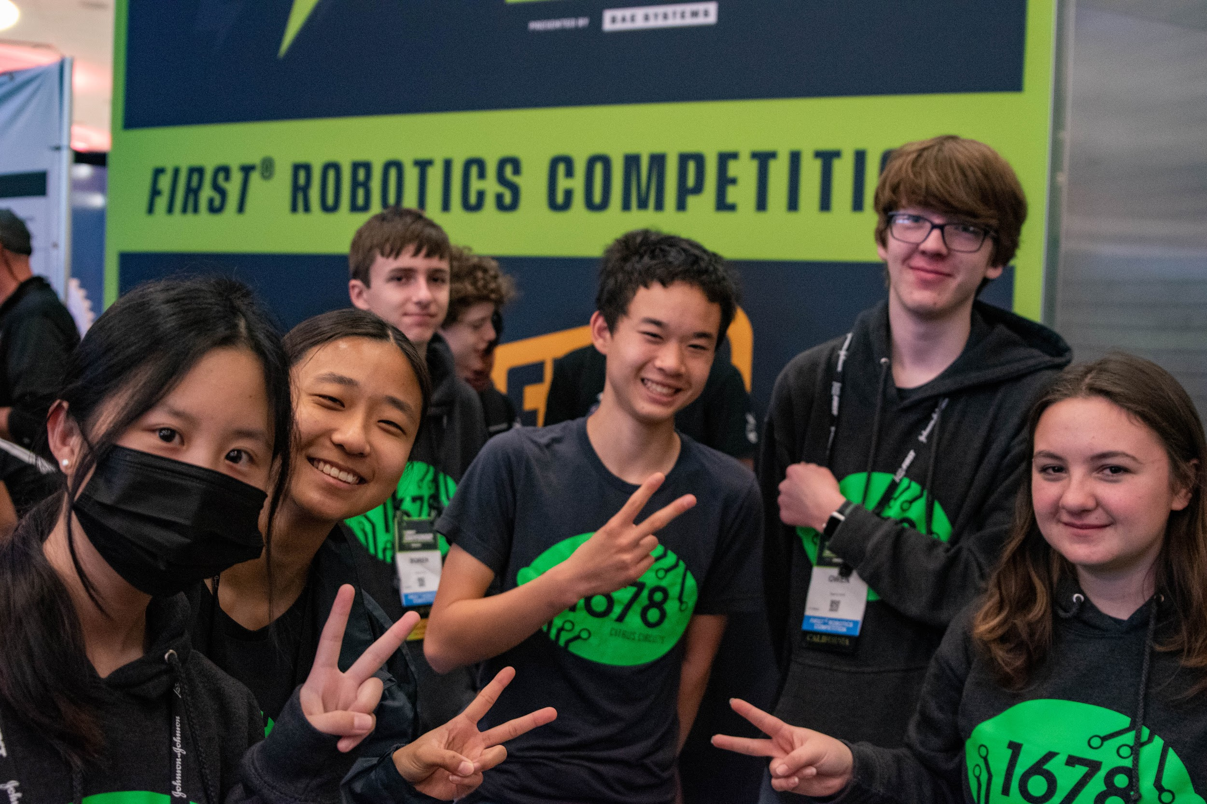
Travel Team
Selection process
  Pit/drive team
  Scouting/strategy team
  Citrus Service team
  Media
Logistics
  Parent chaperones
Notes:
Steven Zhang
Talk abt travel team selection (nominations)
Unique position where we need to pay for all of our student’s travel costs, which limits the number of people
Each group can have a single lead or point person during competition to keep track of time and manage the group. It’s okay for this to be a member of the regular leadership team, or not.

Slide 18
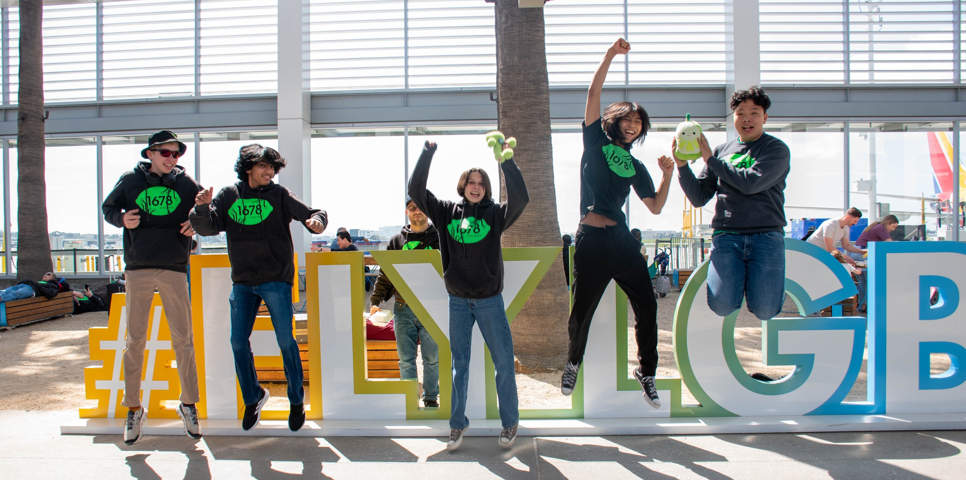
Team Culture and Respect
Be a Good Person
Be a Role Model
  Professionalism
  Responsibility
  Positivity
  Transparency
Culture
  Have Fun!
  Safety and Wellness Committee
Notes:
Steven Zhang

Slide 19

Communication
Platforms
  Slack
  Email
Communicator’s responsibility
  Clarity
  Follow-up
Goes both ways
  Answering questions
Notes:
Steven Zhang

Slide 20

Team Documentation
Google Drive!
  Itineraries & debriefs
  Attendance, outreach, & Registration tracking spreadsheet
Share Drive Folder
  Team Drives (G-Suite)
  Avoid direct link sharing
  Google Groups (sharing, email lists)
Notes:
Kina Li

Slide 21
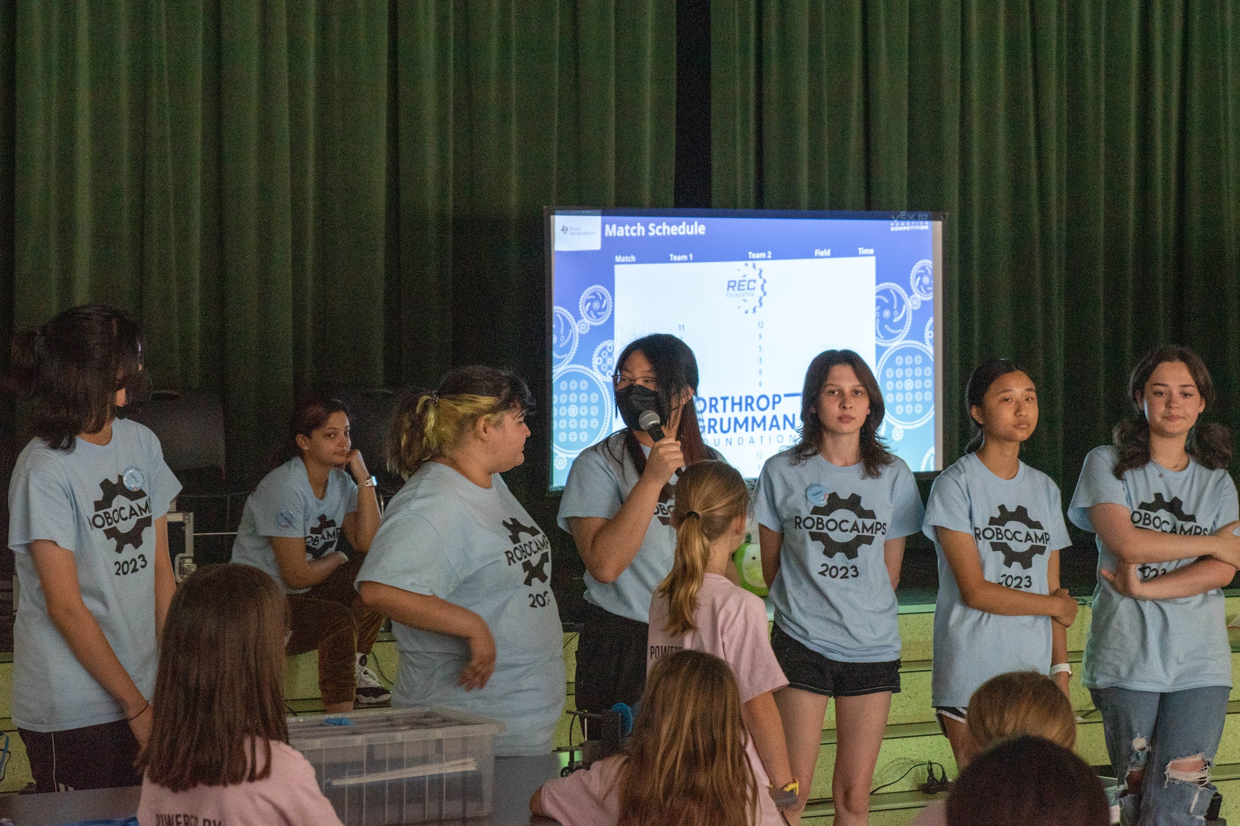
Succession and Future Leaders
Identifying potential
  Dedication
  Attitude
  Initiative
Training
  Smaller leadership opportunities
Applications + Nominations
Notes:
Kina Li

Slide 22

Team Handbook
Rules/Expectations
  Policies
    Attendance
    Behavior
Transparency
Student Contract
Notes:
Kina Li
Our team handbook can be found under the “Resources” header of our website.

Slide 23
We wanna hear from you!
What does your team structure look like?
Notes:
Katie

Slide 24
Comments or questions?
Contact us: administration@citruscircuits.org
Notes:
Katie

Slide 25
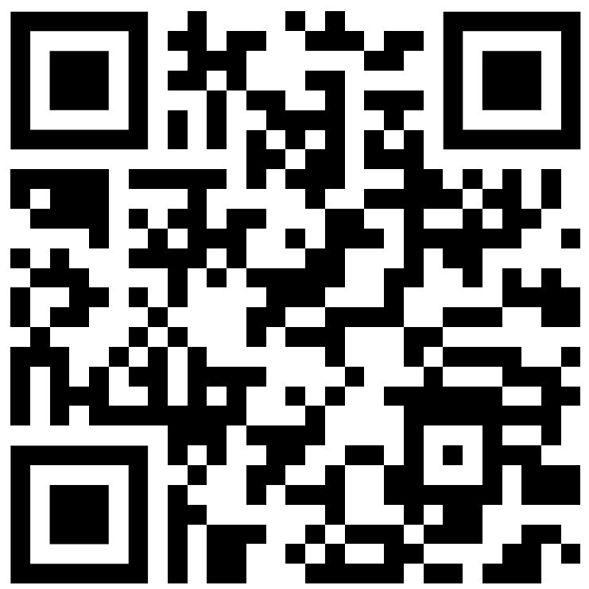
Give us Feedback!
Notes:
Katie

