Slide 1
Citrus Circuits
Fall Workshop Series
RoboCamps: Starting Your Own Program
by Annika Larsen and David Solomon (1678)
Notes:
Annika: Software robot member and Robocamps head counselor
David: Architect by day, Citrus Circuits outreach mentor by night

Slide 2
What is a RoboCamp?
Any camp that inspires the youth to further explore robotics and STEM
Notes:
Annika
Anything that inspires from a science experiment to building a robot.

Slide 3
There is no “Cookie-Cutter” RoboCamp
Notes:
Annika
Though the process to starting your own RoboCamp can be roughly the same, the camp itself can be very different
Explain that because of this, I’ll be going over very broad terms of starting your own camp with no specifications on details like the software/hardware used, how you should run the content of your camp, etc.
I will instead, be going over the baseline needs of starting your own camp and insight that 1678 has learned after years of running this camp

Slide 4
Why do we Have RoboCamps?
Education (be an inspiration!)
Students, counselors, organizers
Team outreach
Community service
Awareness of high school team
Early recruitment pipeline
Team funding
Notes:
Annika
Why?
To educate kids about STEAM and educate counselors on communication skills
Outreach: Mandatory community service, and to make kids aware of our team as well showing that there is something that they can look forward to joining
Finally, we use it for team funding since our camps are paid and therefore generate a profit.

Slide 5
Creating a Balanced Project
Time
The time that you spend on the project
Scope
How many people you reach with your project
Quality
Cost
How much the project will cost to run
Notes:
David
Running a summer camp is a project

Slide 6
What Goes Into Planning RoboCamps?
Collaborators
The who in the project
Logistics
The whens and wheres
Budgeting
The money
Communication
Advertising, emailing, and registration
Camp Content
What the campers are doing in camp
Notes:
David

Slide 7
Collaborators
"Alone we can do so little; together we can do so much."
– Helen Keller
Notes:
David

Slide 8
Are There Enough People Interested?
Needs to be addressed first
Project cannot run if not enough are interested
Take a gauge in the team
Notes:
Annika
First question that has to be answered
You can have the best camp in the world but if kids aren’t interested then you can’t have a camp.
As well as if the students on your team aren’t interested in running it then you can’t have a camp unless you are going to pay people to run it which we will get into later.

Slide 9
Who’s in Charge?
Who will be in charge of what part of camp?
Could split up by job or time frame
Find candidates who are willing to be coordinators
Adult collaborators
Handle money, permits, school districts, etc.
A reference for students when needing advice
Notes:
Annika
Who is running the camp?
This will 98% of the time be an adult running it.
You need to find people who are willing to work with you. From the place that you will hold the camp to the advertisement.
Since there is the fact of handling money, permits, dealing with school districts and equipment that you will be using
Also this will be the person who the counselors look at for advice.
Wouldn’t recommend having one person do everything

Slide 10
Who’ll Run the Camp?
Where will you find camp counselors?
How many counselors? (Recommended number)
More trained counselors = better camp experience
Counselor assignments during camp
Training technical and soft skills
At least 1 trained adult supervisor per camp
Notes:
Annika
Where will you find camp counselors?
From your team? Outsourced?
How will you convince them to be counselors?
How many counselors will you need?
Recommended 1 counselor per ~4-6 campers + 1-2 head counselors + 1-2 floaters/backups
The more trained counselors, the better the experience for campers
Counselor assignments during camp
Training technical and soft skills
Need at least 1 trained adult supervisor per camp
Handles safety, behavior problems, and parent conflicts

Slide 11
Logistics
“Planning is a skill and an art which takes a lifetime to master.”
- Paddick Van Zyl
Notes:
David
This makes it sound intimidating but you don’t need to worry if not everything is perfect. Just worry about the big stuff, the small stuff can be more easily resolved. We’ll focus on the big stuff here, and you’ll learn the small stuff as you go.

Slide 12
When?
Which week(s)?
How many days per week?
How many hours per day?
Any more than ~7 hours will be excessive
Things to take in account:
What dates work for your reserved location
What dates have highest availability
Notes:
David
Which weeks:
Typically your demand (students) and supply (teachers, volunteers, classroom space etc.) dictates summer camps or possible spring break.
How many days per week?
We’ve found planning in 1-week blocks makes lots of sense: bite sized, good curriculum length, affordable, intuitive.
How many hours per day?
Depends on target audience
½ day max for younger kids.
Even for 4-8 graders, more than ~7 hours will be too much for them to focus
Things to take in account:
What dates work for your reserved location
What dates have highest availability

Slide 13
Where?
Secure a location well in advance
Size of the space
Can it accommodate all campers + equipment?
Have a separate space for working and eating
Is the location available for the dates wanted?
Notes:
David

Slide 14
Who?
What age group?
Younger kids may have more behavior issues
Older kids may get bored easily
Suggested between 4-8 grade
Special programs for younger kids (K-3)
How many campers?
Any specific target demographics?
Notes:
Annika
Take in account: Location space, available counselor number, and budget restrictions
Younger kids may have more behavior issues, problems concentrating, and might struggle with technical aspects
Older kids may find technical aspects too easy and get bored easily
Kids of different ages don’t tend to work super well together
Split up kids by the age game

Slide 15
Budgeting
“Budgeting isn’t about limiting yourself – it’s about making the things that excite you possible.”
- Unknown
Notes:
David

Slide 16
What’s the Cost?
Calculate the estimated cost to run the camp
Equipment cost
Renting a venue
Possible wages
Scholarships
Account for more expenses than planned
Notes:
David
Renting a venue - don’t forget insurance! Event insurance easily available online, e.g. EventHelper.com.
Possible wages for counselors or adult supervisors
We partner with the school district, which uses CTE and after-school enrichment funds to sponsor disadvantaged kids in the summar camps. We typically reserve 6 spots in each camp (except girl-only camps).

Slide 17
How Much to Charge?
Base off of how much it costs to run
Plan for positive net worth to put back into expanding outreach
Calculate for how many campers you expect
Offer scholarships
Average camp costs in area
Notes:
David
Look at average costs of other similar camps in your area

Slide 18
What Equipment is Needed?
Make a list of equipment needed
Hardware, computers, chargers, fields, power cords, possible camp shirts, etc.
Inventory what you already have
What materials are given with the venue
Order equipment in advance
Notes:
David

Slide 19
Communication
"Communication – the human connection – is the key to personal and career success.”
- Paul J. Meyer
Notes:
Annika

Slide 20
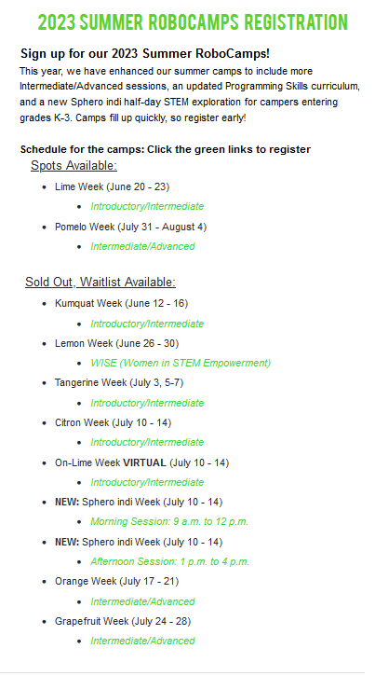
How will you Advertise?
Start early, clear process
Reach your target audience:
Team email for camp questions
Website - Info and registration
Social media, flyers, teachers and schools
Word of mouth!
Notes:
Annika
Start advertising a few months (or more) before camp
How can you best reach your audience?
Email
Have a team email account where campers can ask questions
Social media
Flyers
Website
A place where campers can find more information and register
Teachers and schools
Have your teammates advertise to their friends and family!
Advertise the registration link with a drop date

Slide 21
How will Campers Register?
Google Form
Simple to set up
Harder to manage
Not as official
VS.
Event Platforms
Might cost money
More complicated
More features
Notes:
David

Slide 22
Camp Content
“I never teach my pupils; I only attempt to provide the conditions in which they can learn.”
– Albert Einstein
Notes:
Annika

Slide 23
What will the Campers be Doing?
List of camper learning goals
Design, programming, teamwork, etc.
Base activities on the age group of campers
Familiarize yourself with robot hardware and software
What should the camp build towards?
End of the week competition or final challenge
Show and tell
Notes:
Annika
What will be happening in the camps?
What do you want the campers learn?
How to program to how to build a robot
Base the activities on the age of your group
You don’t want kindergarteners to try and code with java it just won’t work
Familiarize yourself with robot hardware and software
Before we go on to break we have a meeting with people who are going to be a camp counselor to make sure that they know how to code and build the robot base that we use for our camp
What is your end goal?
Whether this is a goal to teach the kids code or to get kids interested in robotics or even just making sure the kids have fun.
We focus on all of these by working to a competition at the end of the week were parents can come and watch. Seeing how happy their kids are which makes them want to come back and have their kid do it next year.

Slide 24
How will the Campers Learn?
Organized lessons
Follow along activities to learn code, design, etc.
Counselor to camper walk through
Will campers work in teams or individually?
More campers = more arguing + less contribution
How will you split up teams?
Notes:
Annika
How will the campers get to these goals?
We hold organized lessons which can walk them through code and how to build their robot.
These kids will be split up by the age game so we can split up any friends that they came with to introduce them to new people (Kids get sneaky when they realise what you are doing so make sure that you know on the first day who’s really close friends (you can usually tell)
We also have counselors sitting with a pair of campers so that they are having a more personal connection and they are more willing to get work done.

Slide 25
What’s the Schedule?
Day to day schedule
Monday, Tuesday, etc.
How will you keep campers focused?
Minute to minute schedule
During the morning, afternoon, break times, etc.
Icebreakers 1-2 times a day
Notes:
Annika
Keep campers focused through added challenges, engaging activities, challenging them to do better and having them do a certain task in front of you
When will breaks/snack time be?
The younger the campers, the more breaks you should account for
Ice breakers 1-2 (tag, games, STEM activities)

Slide 26
Dealing with Problems?
Kids get bored easily which can lead to acting out
2 Warning system
Calls home
Made by head counselors and adults only
It’s ok to be firm as a counselor just don’t be mean
Notes:
Annika
Warnings are different from saying not to do something, (If giving a warning say the words 1st warning) - use best judgement
There will be kids who don’t know better and won’t listen to you. As a reminder there should always be an adult there where you can pull them over if something is really happening that is bad. (losing eyesight on a kid or someone bullying someone else)
These kids are soft but you should be firm with them and even if parents get involved if you had a good reason to do what you did then you will be fine (just make sure that you clear it with your adult that is there)

Slide 27
How to Keep the Program Running
Document everything
Write down your entire planning process
Include what worked and what needs to be changed for next year
Collect feedback from campers and counselors
Train others to take over in the future
Notes:
David
Make it easier for future years and document your entire process while planning!

Slide 28
Organization is Key
Put yourself in the shoes of your audience
If I was a parent, what would be more convenient?
If I was a camper, what would be the most fun?
Base camp can expand to many others
Stay organized!
Start planning well in advance (now!!)
“Steal from the best, invent the rest.”
Notes:
Annika
Throughout the process put yourself in the shoes of your audience
If I was a parent, what would be more convenient?
If I was a camper, what would be the most fun?
Base camp can be spun off to expand to many others
Can have different level camps (advanced + intro), all girl camps, coding specific camps, etc.
Stay organized!
The more you plan, the smoother it will go
Write out what campers and counselors will be doing during camp
Start planning well in advance (now!!)
Learn from those who are already doing it!
“Steal from the best, invent the rest.”

Slide 29
Resources
RoboCamps Website
https://www.citruscircuits.org/robocamps.html
RoboCamps Resources Page
https://www.citruscircuits.org/robocamp-resources.html
Notes:
Annika
We are currently in the process of updating our Guidebook but if you would like to send your email we can tell you when it’s updated.
Robocamps webpage

Slide 30
Last Words of Advice
“I have not failed. I've just found 10,000 ways that won't work.”
- Thomas A. Edison
Notes:
David
Edison was wrong, there are really 10,001 ways to make it work. Again, don’t worry about making it perfect the first time, as long as you document your process you will learn and improve each year

Slide 31
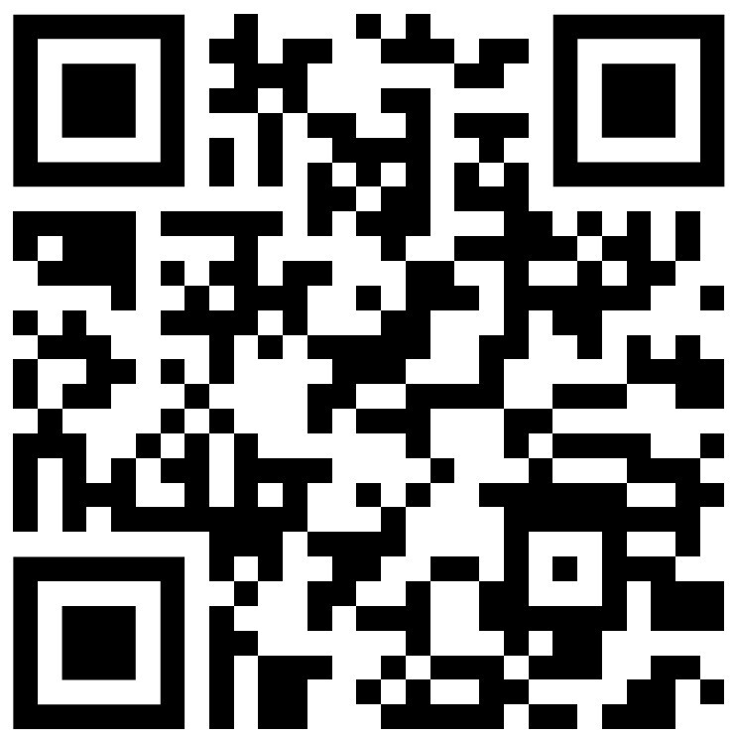
Survey:
Notes:
Annika
Please tell us how we did on this presentation we appreciate your feedback!
QR code is for a survey for attendees

Slide 32
Citrus Circuits
Fall Workshop Series
Contact Us @
davisyouthrobotics@citruscircuits.org
Thank You! Any Questions?

