Slide 1
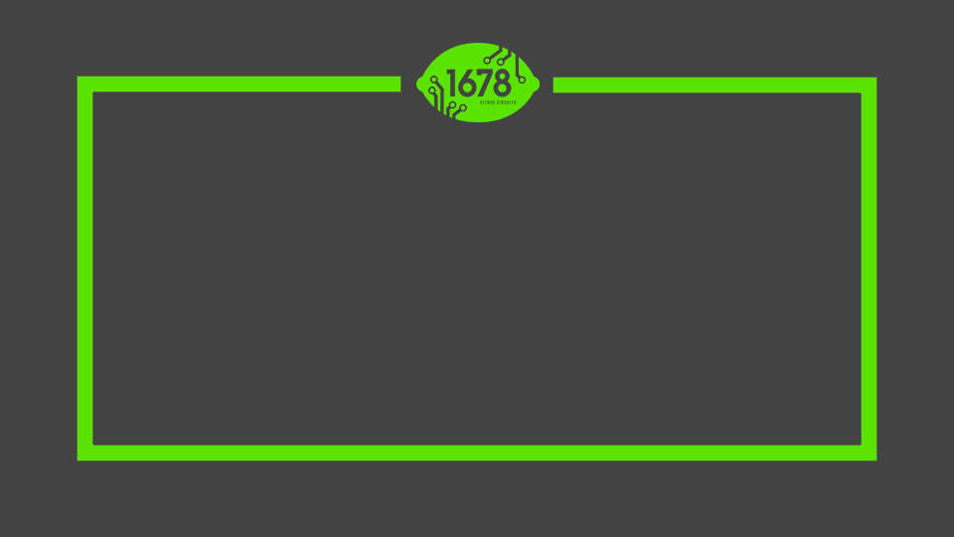
Citrus Circuits
Fall Workshop Series
Draft Night Tool:
The Picklist
Mehul P.
Nathan M.
Notes:
Mehul

Slide 2
“Your robot wins matches,
your scouting wins competitions”

Slide 3
Why are you here?
You are a consistently high-seeded alliance captain focused on a strong second pick
You have been a low-seeded captain looking for a well-balanced alliance
You are a rising team preparing for being an alliance captain
You are a team who has/hasn’t been picked by other alliances looking to understand how these choices are made
Notes:
Mehul

Slide 4
What if we’re a high-seed captain?
Top ~1-4
Look for offensive power in your first pick
Technical capability is a plus
Consistency is key
Look for utility in your second pick
Often auto/endgame points
Versatility in teleop
The higher you seed, the lower your second pick
Notes:
add: The competitive success of the top seeds is often rooted in finding hidden gems in the second pick.
Mehul

Slide 5
What if we’re a low-seed captain?
Top ~5-8
Prepare for all scenarios; game it out
Look for complementary strength in your first pick
Pick a robot that can do what you can’t do
Lower seed captains will need to take a gamble
Less consistent, higher ceiling
Your second pick should fill holes
Which alliance captain will you face?
You will have a strong second pick
Notes:
Mehul

Slide 6
What if we’re seeded low?
Talk to the teams that are seeded high
Find out their criteria
This presentation is an example!
Could you be a first pick or a second pick?
First pick - offensive power (usually)
Second pick - alliance dependent
Understand that any alliance can pick you
Be cooperative in quals and follow match strategies
Be reliable and consistent - even more important now with double elimination playoffs
Notes:
adds: Having other resources can be a big plus. Our first pick at Champs in 2014 as influenced by that. On the other hand, top teams often leave teams considered to be uncooperative off their draft lists entirely, no matter how good on the field.
Mehul

Slide 7
Golden Rule No. 1:
Regardless of your seed, scouting data is vital for success.
Notes:
adds: Having other resources can be a big plus. Our first pick at Champs in 2014 as influenced by that. On the other hand, top teams often leave teams considered to be uncooperative off their draft lists entirely, no matter how good on the field.
Nathan

Slide 8
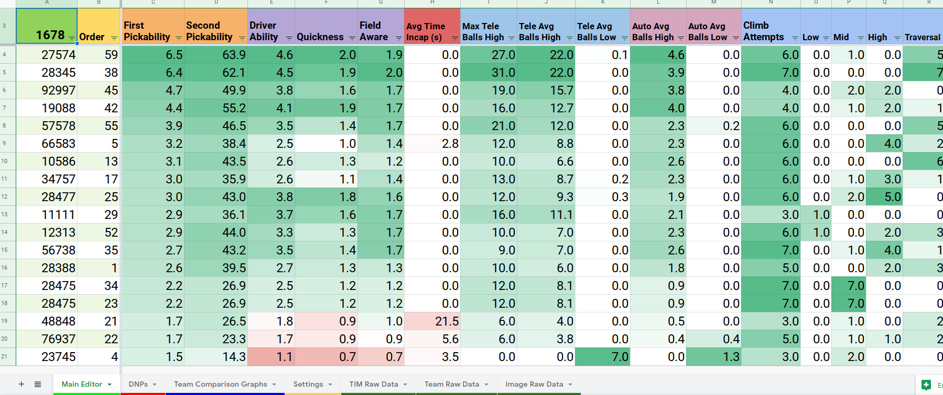
Scouting Data
Optimized visualization
Spreadsheets are great
Needs to be set up beforehand
Spreadsheet formatting
Conditional
Number
Freezing
Alternating colors
Filters
See our Scouting Systems workshop
Notes:
False data
Nathan

Slide 9
Golden Rule No. 2:
By splitting different tasks into different roles, more insights on teams can be gathered for a picklist meeting.
Notes:
adds: Having other resources can be a big plus. Our first pick at Champs in 2014 as influenced by that. On the other hand, top teams often leave teams considered to be uncooperative off their draft lists entirely, no matter how good on the field.
Mehul

Slide 10
What are possible roles?
Match Strategist
Uses the data gained from scouting to create our strategies for individual matches
Pit Scout
Prior to the first day of quals, gathers data on each robot in-person
Stand Strategist
Gather insight on each robot via watching quals/practice matches
Subjective Scouts
Rank each robot in an alliance via speed, quickness, etc.
Notes:
adds: Having other resources can be a big plus. Our first pick at Champs in 2014 as influenced by that. On the other hand, top teams often leave teams considered to be uncooperative off their draft lists entirely, no matter how good on the field.
Mehul

Slide 11
Picklist Formation
Notes:
Mehul

Slide 12
Meeting Logistics
Who participates?
More people → More input → Less productive
Logistics
Visual Aids
Projector
Dinner
What position are you in?
Seeding
Predictions
Notes:
add: We found that having dinner with the team earlier lengthened out night by more than an hour.
Mehul
Mehul

Slide 13
Golden Rule No. 3:
If your team is 12th seed or above, it’s essential that you create a picklist. Even if not, a picklist is a helpful tool to have.
Notes:
adds: Having other resources can be a big plus. Our first pick at Champs in 2014 as influenced by that. On the other hand, top teams often leave teams considered to be uncooperative off their draft lists entirely, no matter how good on the field.
Nathan

Slide 14
Identify Your Goals
What are your criteria?
Valued attributes/data points
First vs. Second pick
DNPs
List length - 24 for regionals, 32 for champs
Meeting length
Predict alliances if you’re seeded high
Notes:
add: We develop our ranking criteria starting at Kick off and refine through the season. We often restructure in competition mid season.
Nathan

Slide 15
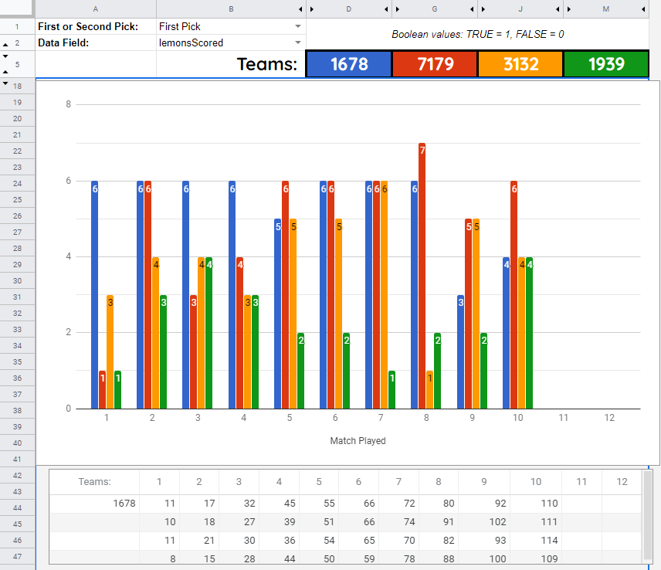
Creating an Initial Picklist
Meeting with known alliance partner
Grind through the data
Scouting data
Match videos
Graphs/trends
Anecdotes
Observations
Discuss, Debate, Decide!
Pairwise rankings
Pros and cons
Play devil’s advocate
Group consensus
Maintain productivity
Notes:
add: First picks can often be fairly obvious, especially of higher seeds, but second picks require closer attention. The latter pick list usually is longest part of the meeting.
Nathan

Slide 16
Draft Execution
Notes:
Mehul

Slide 17
Draft Day Prep
Reevaluate your list as you watch matches
Make pairwise comparisons of teams in the same match
Watch for large improvements or problems
If you’re in top 4, prepare to talk to prospective alliance partners about willingness to join
If you’re going to be in the top 2 alliances, be ready to compare lists before the draft occurs
Notes:
add: We found that having dinner with the team earlier lengthened out night by more than an hour.
Mehul

Slide 18
During the Draft
Go out with a single list in order
But your team representative needs to watch for texts
Cross off teams as they are chosen
Compare your draft list with your alliance mates
Discuss your alliance strategy and what’s needed
Defer to the alliance captain but state any objections to a prospective choice
Make a case for a hidden gem, but don’t dwell on nuances
Make new friends with your alliance and play hard!
Notes:
add: We found that having dinner with the team earlier lengthened out night by more than an hour.
Mehul

Slide 19
Golden Rule No. 1:
Robots win matches, scouting wins competitions
Golden Rule No. 2:
Delegate strategy roles for maximum insights
Golden Rule No. 3:
Picklists are essential for deciding which robots are best for you
Notes:
adds: Having other resources can be a big plus. Our first pick at Champs in 2014 as influenced by that. On the other hand, top teams often leave teams considered to be uncooperative off their draft lists entirely, no matter how good on the field.
Mehul

Slide 20
Example Picklist

Slide 21
Citrus Circuits
Fall Workshop Series
strategy@citruscircuits.org
Thank You!

