Slide 1
Citrus Circuits
Fall Workshop Series
CAD Principles
By Brendan Rockwell and Sam Calvert

Slide 2
Who are we?

Slide 3
Who are we?
Brendan R.
4th year in FRC
Design Lead on 1678
Sam C.
4th year in FRC
Impact Award Lead

Slide 4
Outline
Outline
What is CAD useful for?
CAD Organization
(For Onshape)
The CAD Process
Mechanism Design
CAD Standards
CAD & Manufacturing
Notes:
Brendan

Slide 5
What is CAD
Computer Aided Design
Onshape, Solidworks , Autodesk
Way to visualize your design before spending resources to manufacture and assemble it
Notes:
Image: 1678 robot release CAD
Speaker: Sam

Slide 6
Why does this matter?
In order to develop advanced robots, using industrial machines, CAD is essential
Interference checks
Custom gearboxes
3D modeling
File generation
Notes:
Speaker: Sam

Slide 7
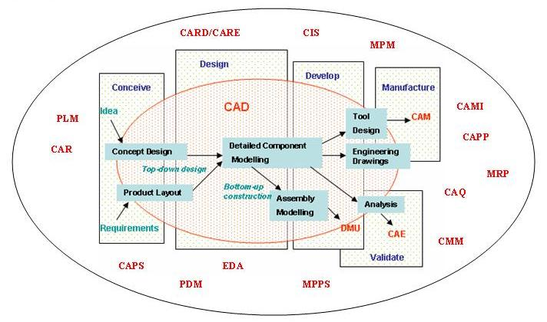
Notes:
Speaker: Sam

Slide 8
CAD Organization
Notes:
Remember to say a lot of this will be Onshape specific, but some is applicable everywhere

Slide 9
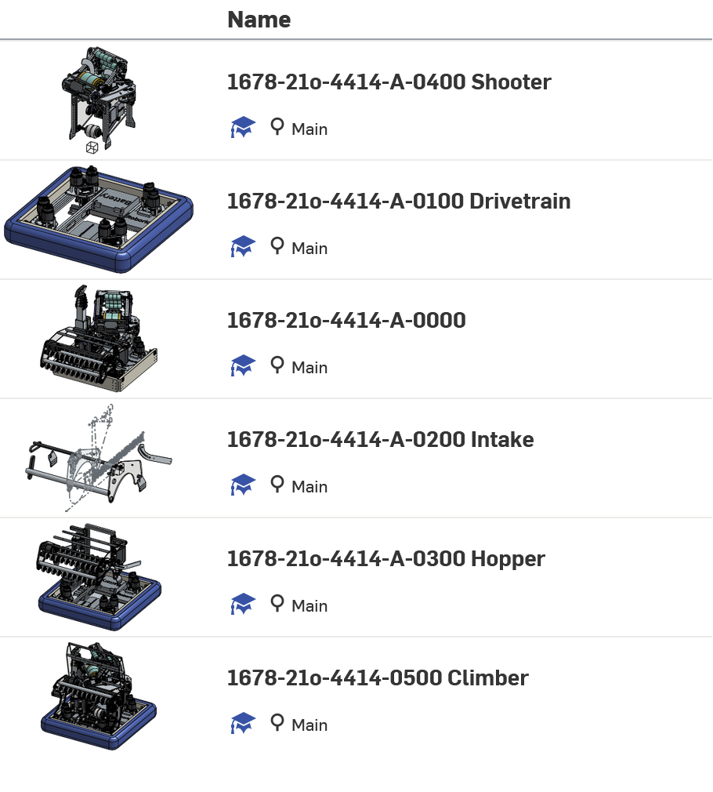
CAD Organization
Have a top level assembly
Every single part inside
Separate subsystems
Completely Independent
Minor Part Studios
MINIMIZE LOAD TIMES
Notes:
Image: Image of 2022 Beta Robot Folder
Speaker: Brendan

Slide 10
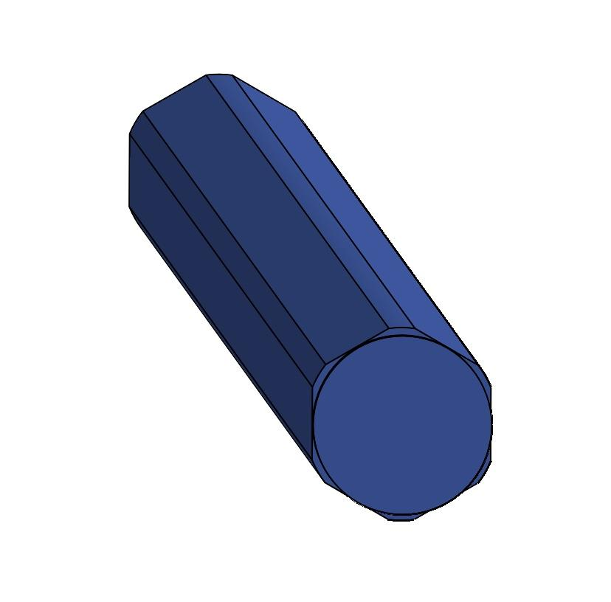
Division of Labor
Limited work + limited experience
Opportunity to train and delegate
Bypasses tunnel vision for experienced members
Notes:
Image: Simple hex shaft :thumb:
Speaker: Sam

Slide 11
Mechanical Design

Slide 12
“The process of using available resources to efficiently develop a mechanical solution to a series of problems or challenges”
Notes:
Sam
Important to think about mechanical design as a series of problems and solutions, rather than a single creation
More like a math problem than a painting
Each problem can be solved individually, and brought together to make a final product
This frame of mind makes the process very effective

Slide 13
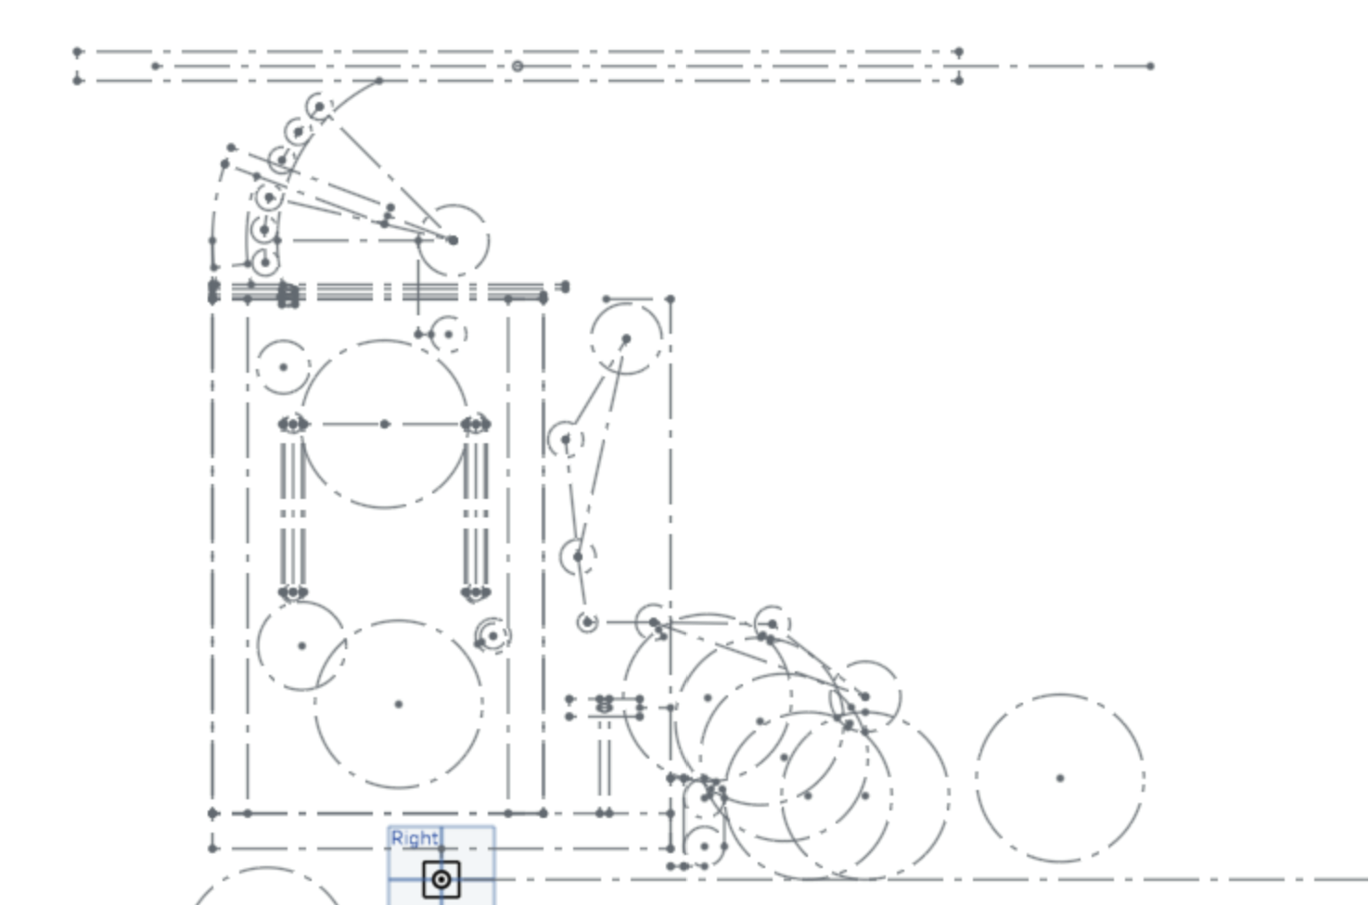
Starting Out
Start robot design with a single overall sketch
Contains superstructure, and estimates of mechanisms
Use to check the feasibility of the design
Helps subsystem leads understand interactions
Notes:
Image: Mockup of 2023 robot
Speaker: Brendan

Slide 14
Beginning Mechanism Design
Write down what the subsystem needs to deal with/do
Intake → Pick up game pieces and survive harsh impacts
Two types of durability
Elastic and Rigid
Establish the power chain and goal motor ratios
Notes:
Image: Elevator Assembly
Speaker: Brendan

Slide 15
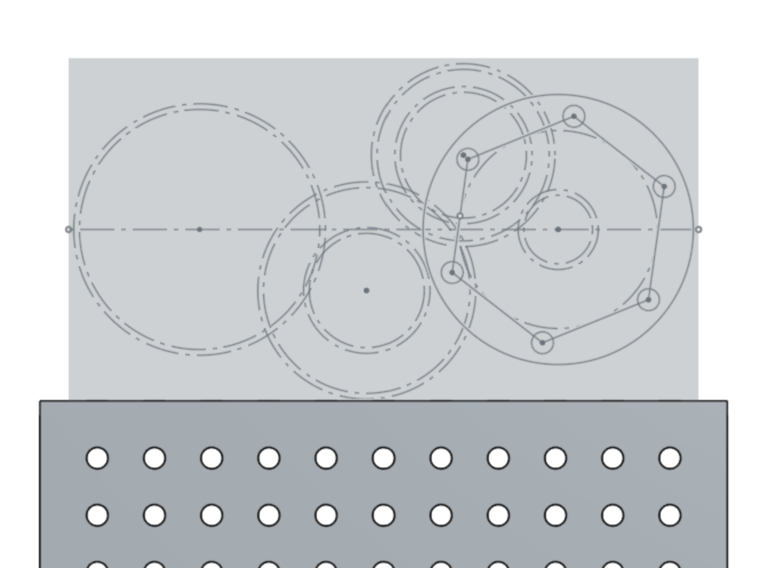
How To Know Ratios?
Using the expectations for the subsystem, identify three things
Goal Stall Torque
Goal Motor Draw
Goal Move Time
Notes:
Image: Gearbox idk
Speaker: Brendan
Uhhhh just some notes on this one, dont get too technical, dont walk around telling kids to use FEA or anything, just tall about for torque: if big thing need move, it better be large, trying to keep motor draw low (aka dont have it crazy high) and then move time is subsystem dependent, give examples and talk about the generics of how to figure it out

Slide 16
CAD Standards

Slide 17
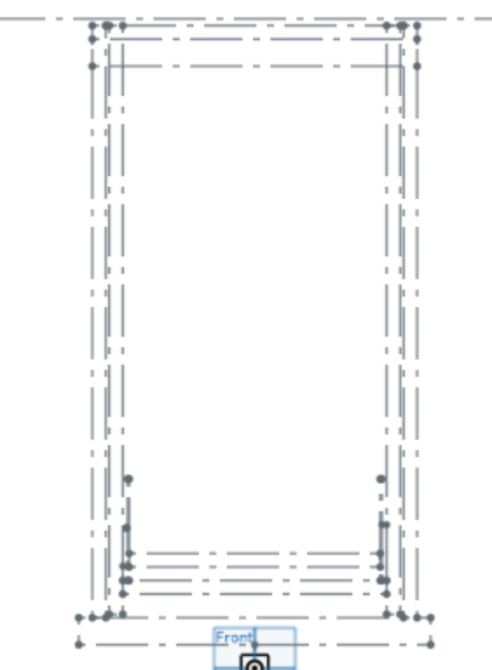
Reference Sketches
Levels of detail depending on the complexity of the mechanism
Model all potential movements of the mechanisms and game pieces
Establish the location of major structural elements
Notes:
Image: Shooter Reference Sketch
Speaker: Sam

Slide 18
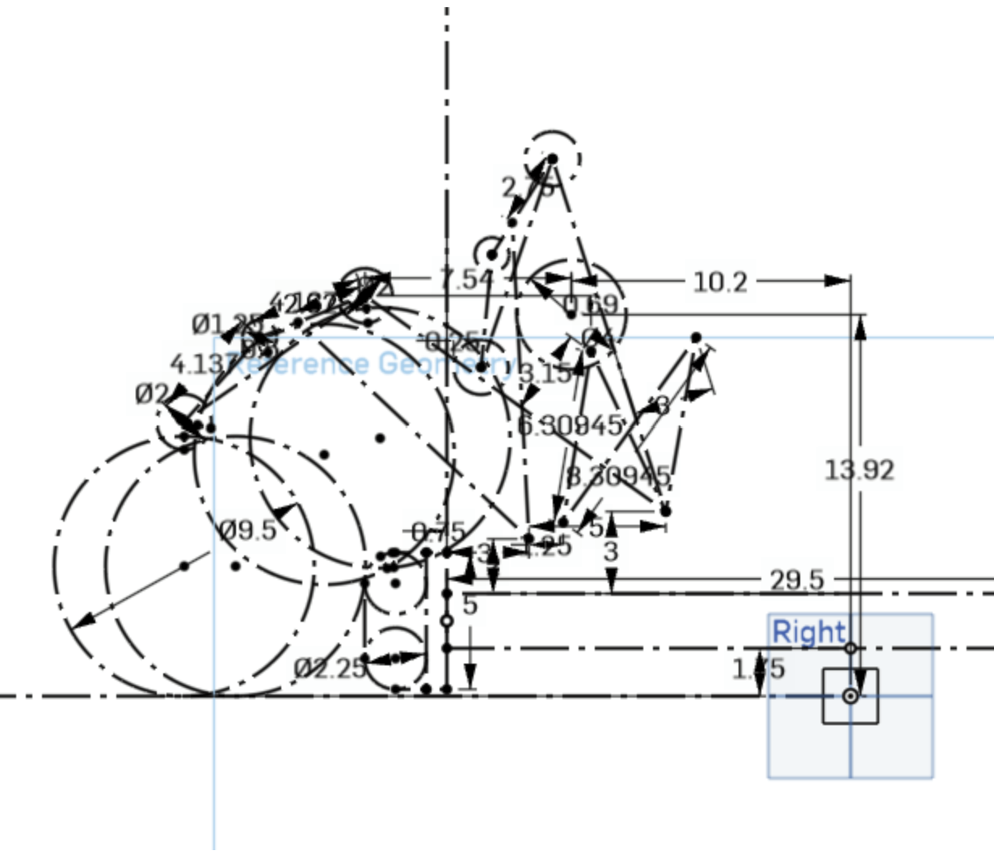
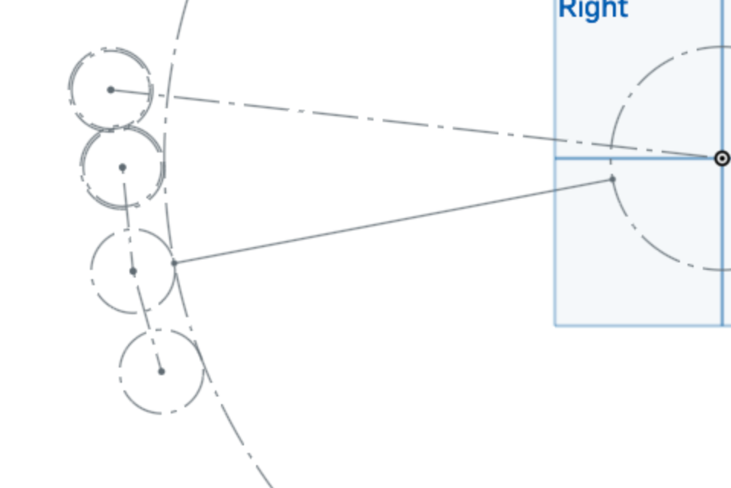
Notes:
Image: Elevator Reference, Shooter Reference
Speaker: Sam

Slide 19
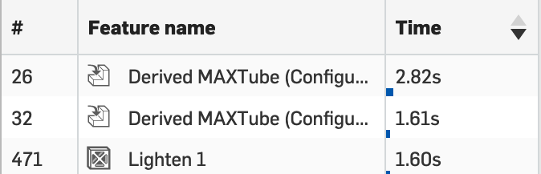
Moving Forward
When generating parts, try to have any large load time modifications at the end
Featurescripts, Large Pattern Features, etc.
Every custom part should be created, but small parts can be separate to reduce load times
Notes:
Image: Elevator Part Studio
Speaker: Sam
Fill Time

Slide 20
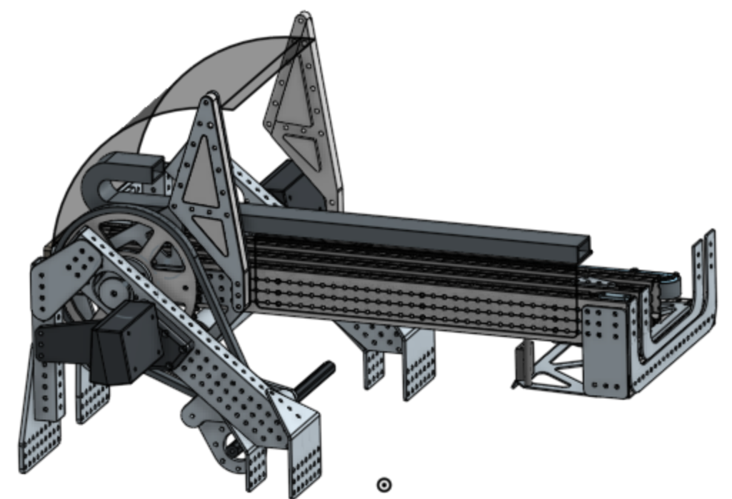
Notes:
Image: Intake Part Studio
Speaker: Sam

Slide 21
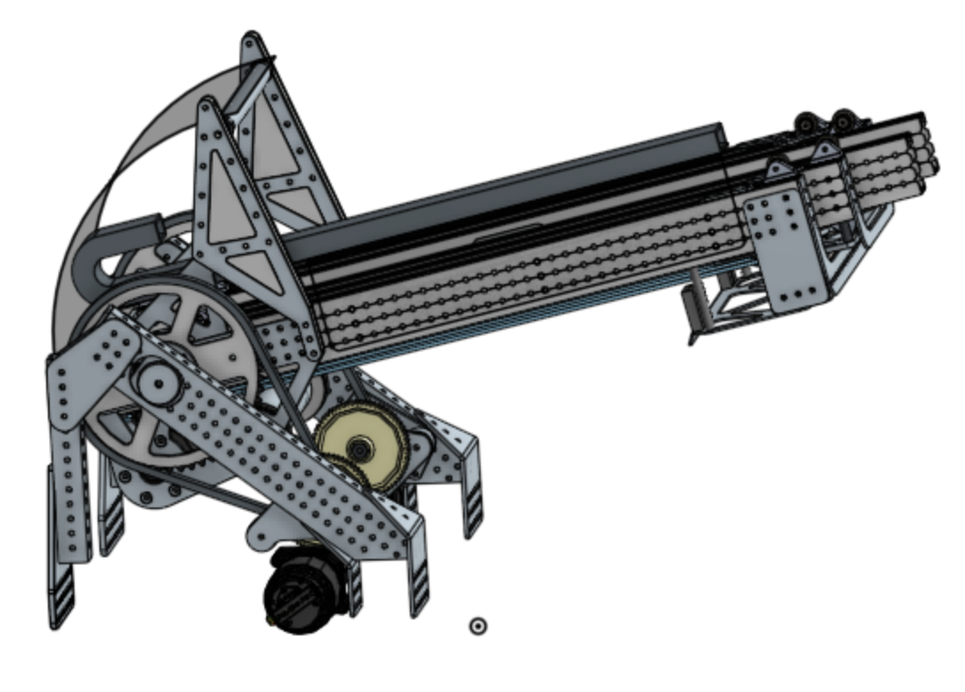
How To Create Assemblies
Model every COT or custom part that will be used in assembly EXCEPT fasteners
Fasteners drastically increase load time for little gain
Make sure every potential movement is modeled
Notes:
Image: Idk man pick an assembly
Speaker: Brendan
Fill Time

Slide 22
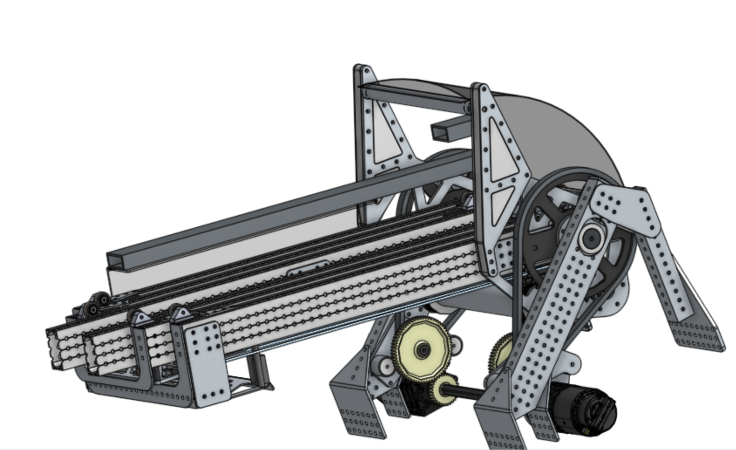
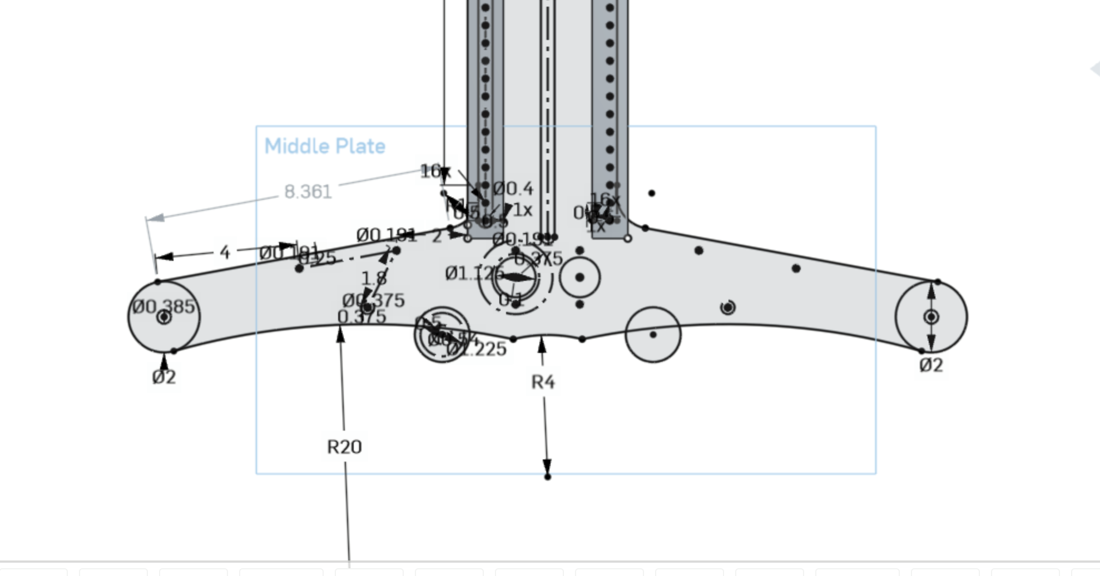
How To Create CAD for Iteration
Make sure sketches are designed around use features
Try to use dimensions as little as possible
Use group mates as much as possible
Try to have as little directly based on something else as possible
Notes:
Image: Idk man pick an assembly
Speaker: Brendan
Fill Time

Slide 23
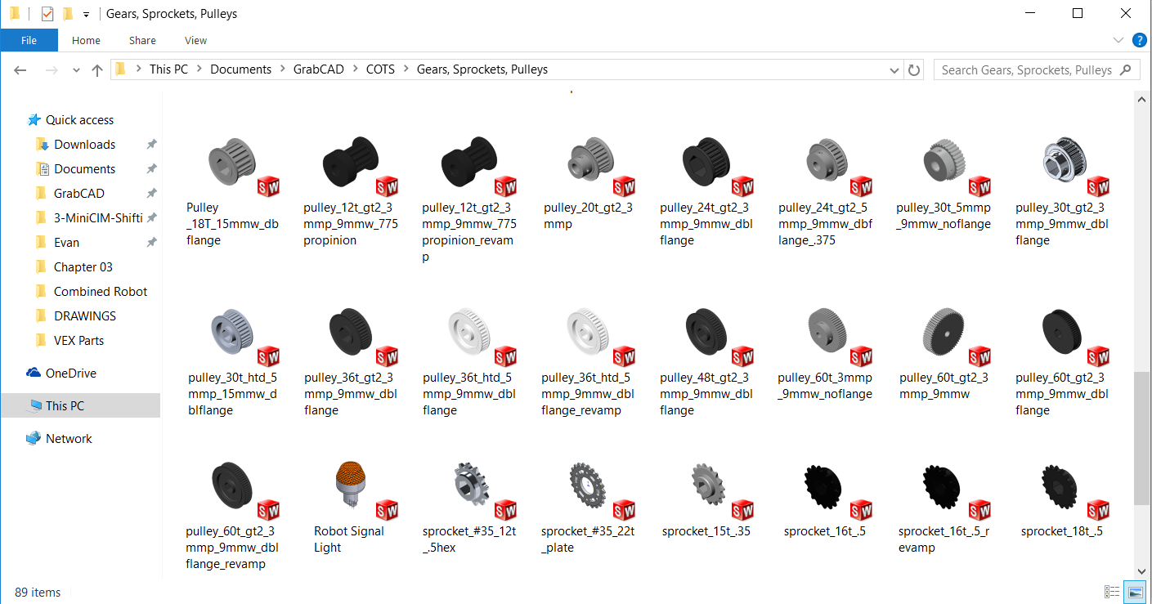
COTS Libraries
Having a standard team-wide library increases efficiency immensely
Makes it easy to find files when putting together assemblies
Everyone has the same version, so no potential conflicts
Notes:
Image: MKCad
Speaker: Brendan
Fill Time

Slide 24
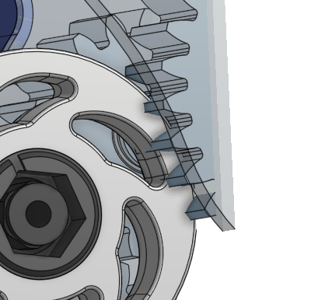
Interference Checks
Arguably the most valuable thing that CAD gives us
Using section view, check every potential interference, at all locations
Also make sure the separate subsystems don’t interfere with each other
Notes:
Image: Idk man pick an assembly
Speaker: Brendan
Fill Time

Slide 25
From CAD to Manufacturing

Slide 26
The 1678 Process
Design students label each part inside of the CAD software
An external spreadsheet exists to track part status and details
Use CAD for Part Drawings, DXF files, STL’s and more
Communication is key
Notes:
Image: Idk man pick an assembly
Speaker: Sam
For the communication thing: “Designers job doesn’t end when the CAD is finished, still have to work with frabircation to make sure that everything goes smoothly, and work to make sure all the issues are resolved”

Slide 27
Part Drawings
Enables fabricators to make parts without having the CAD open
Need to be as clean as possible, while sharing all necessary information
Define everything from one corner as to limit the number of times machinists have to zero machines
Notes:
Image: Idk man pick an assembly
Speaker: Sam
Fill Time

Slide 28
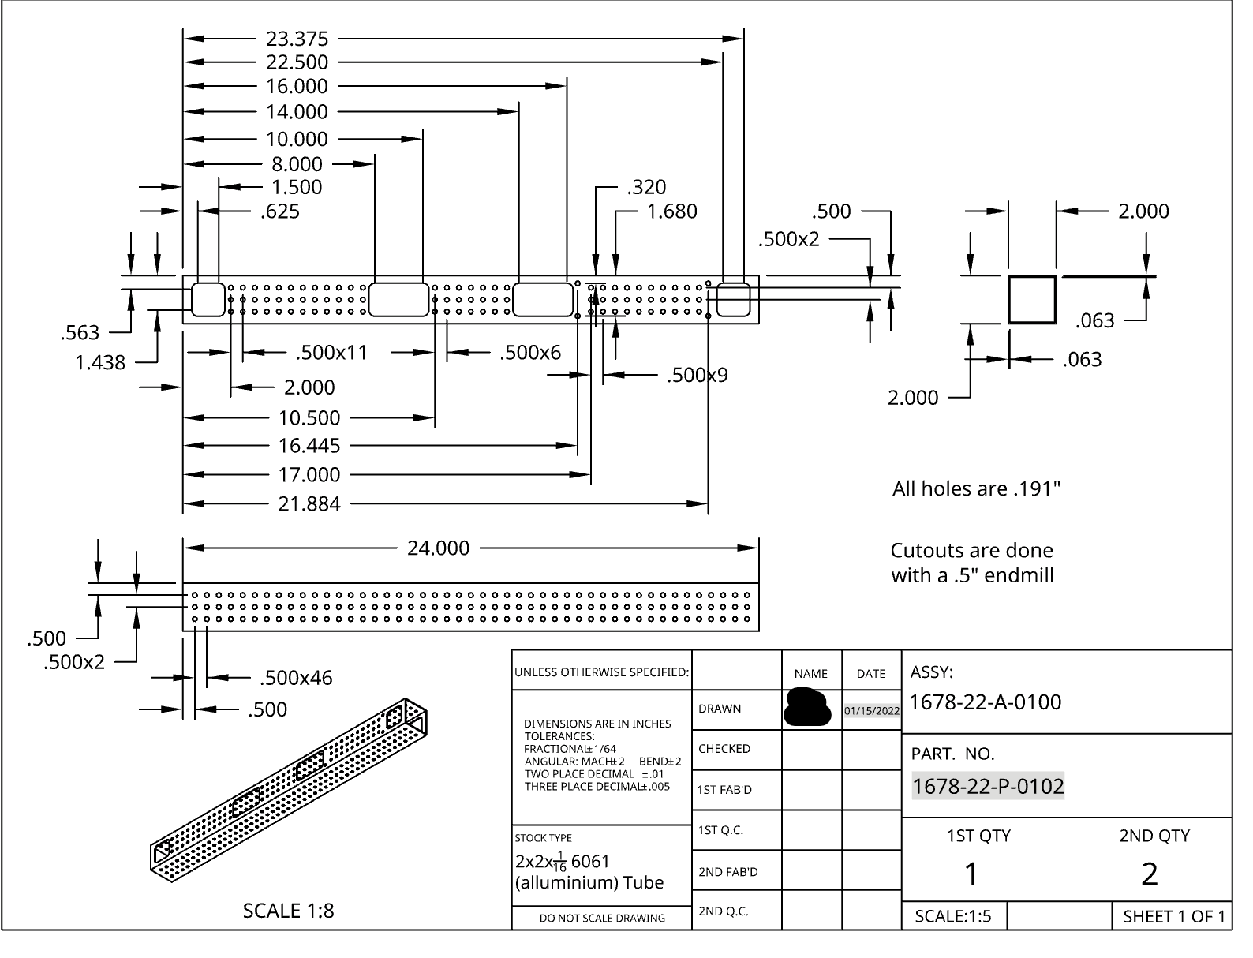
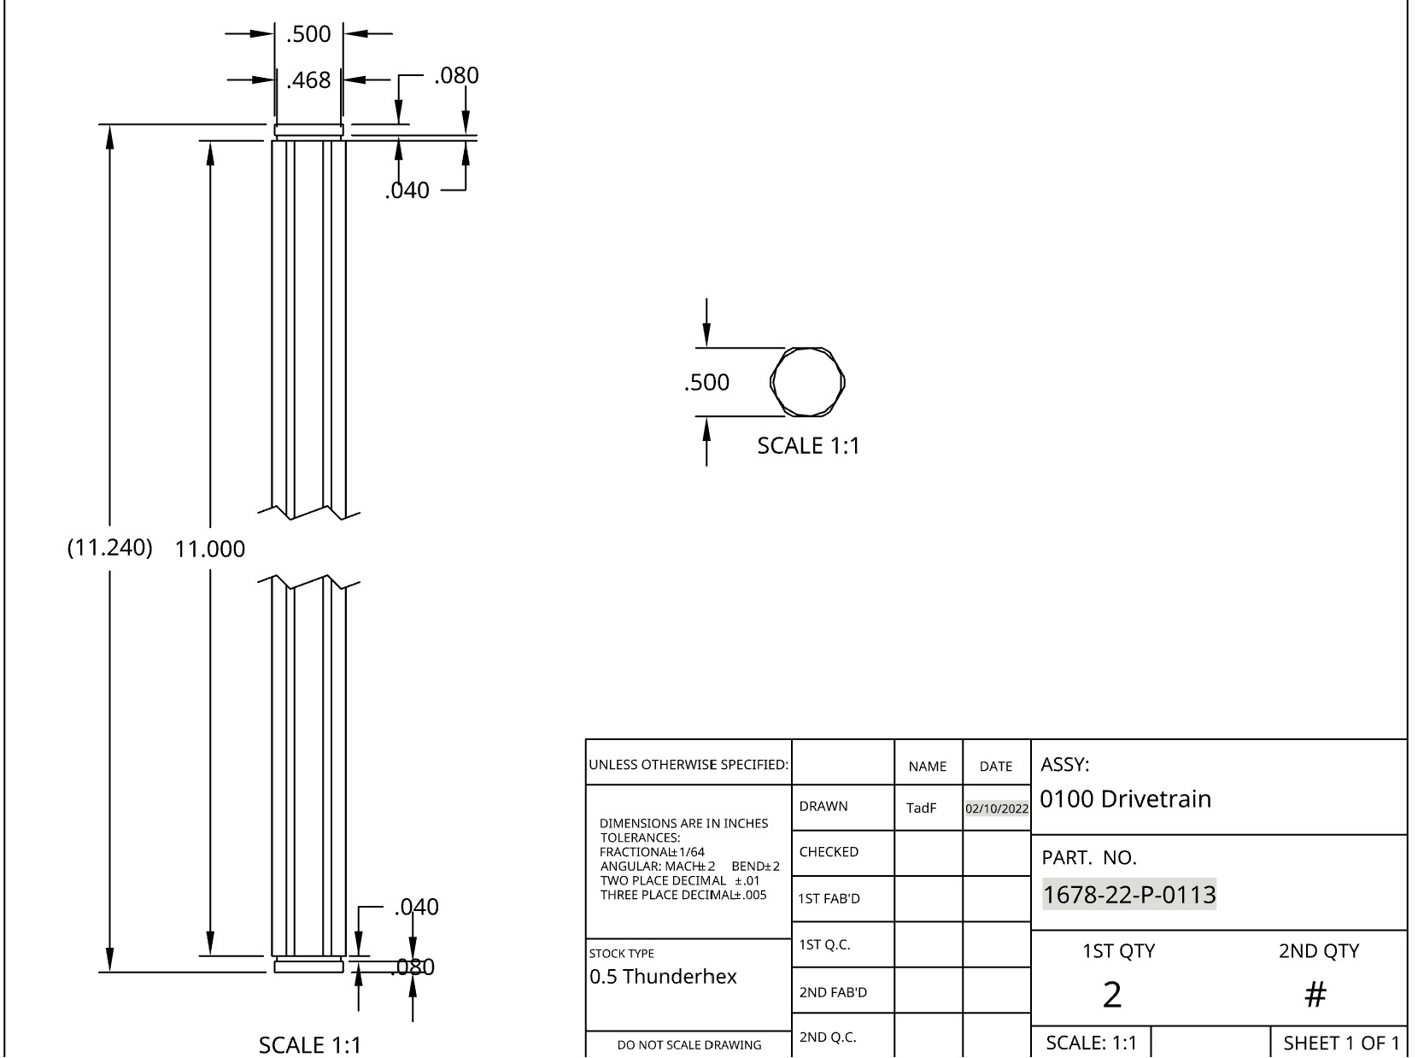
Notes:
Image: Idk man pick an assembly
Speaker: Sam
Fill Time

Slide 29
Citrus Circuits
Fall Workshop Series
bmrockwell.dc@gmail.com
Thank You!

